Slide 1
Welcome!
We will begin in a few minutes
For greetings: Please use the “Chat” feature. Choose “All Panelists and attendees”
For questions: Please type your questions in the Q&A window on the bottom of your screen.

Slide 2
2022 Manual Revisions

Slide 3
Sponsorship Manual

Slide 4
4.3.13 Use of Computers, Networks, Internet and Email
Reason for revision: Additional data protection policies
New points:
All Unbound staff members are required to take and pass internet security training at least once a year
Data backups can use online storage services such as Microsoft OneDrive, or Google Drive or physical storage away from the project office
All software licenses must be legal and up to date
Email:
Personal email addresses should not be used
Use email addresses that can be administered by the project – e.g. intl.unbound.org
All employees are required to have an individual intl.unbound.org email account
Notes:
All Unbound staff members are required to take and pass internet security training at least once a year
Projects are required to regularly back up the data stored on project computers (preferably once per week) and store the backup data using an online storage service, such as Microsoft OneDrive or Google Drive, or physical storage at an offsite location.
All software licenses, including for Microsoft Windows, must be legal and still supported by the manufacturer. For example, Windows 7 is no longer supported by Microsoft, so all computers should be updated to a supported version of Windows, or the computers should be replaced by newer ones with newer operating systems. All software should be kept up to date with updates from the manufacturer.
Employees should not use their personal email addresses for their work at Unbound. A separate email address should be used for Unbound purposes only. Email addresses byfor Unbound staff should be administered by the project and should be able to be deactivated by the project to keep information secure. Examples of emails that can be administered by the project are intl.unbound.org email addresses. Examples of emails that cannot be administered by the project are addresses that end in hotmail.com or gmail.com and cannot be used as an Unbound work account. Email accounts ending in intl.unbound.org are available from Unbound Kansas if additional email accounts are needed. All employees are required to have an individual intl.unbound.org email account, which is needed to access the annual security training and, depending on the employee’s role, other Unbound systems.
For more generic email addresses, such as AccountingSubprojectABC@intl.unbound.org, if this account is ever transferred from one employee to another, the password should always be changed when the new employee gains access to the account.
Portal, Abila, Translation Module and Yammer accounts should be specific to one user and should not be shared by multiple users. Passwords for these accounts should only be known by the user to whom they belong and should not be shared with others. Additional accounts are always available from Unbound-Kansas if additional people need access to these systems.
Email accounts that are shared by more than one employee should not be entered as an employee’s email address when registering for Abila, Portal, the Translation Module or Yammer. Email accounts entered for each user for these websites should be specific to the individual.
If an email address for an Abila user changes, Kansas should be notified immediately so the email can be changed in Abila. Email addresses associated with Portal or Translation Module accounts should be updated by each user or the project administrator if any changes are made.
Upon separation of employment of an employee from Unbound, the Kansas regional team should be notified immediately. The individual work email of the departing employee should be inactivated immediately by the project, or the password should be changed so that it can no longer be accessed by the former employee
If the departing employee had access to a more generic email address used by multiple people, such as ProjectCorrespondence@intl.unbound.org, the password to this email should be changed immediately upon the employee’s departure from Unbound.
The Portal Project Admin should remove the roles of the departing employee’s Portal account immediately.

Slide 5
4.3.13 Use of Computers, Networks, Internet and Email
Reminders:
If an email address for an Abila user changes, Kansas should be notified immediately
Email addresses associated with Portal or TM accounts should be updated by each user or the project administrator
Kansas regional team should be notified immediately upon separation of employment of an employee. The individual work email of the departing employee should be suspended immediately by the project, or the password should be changed.
If the departing employee had access to a more generic email address used by multiple people, such as ProjectCorrespondence@intl.unbound.org, the password to this email should be changed immediately upon the employee’s departure from Unbound.
The Portal Project Admin should remove the roles of the departing employee’s Portal account immediately.
Notes:
All Unbound staff members are required to take and pass internet security training at least once a year
Projects are required to regularly back up the data stored on project computers (preferably once per week) and store the backup data using an online storage service, such as Microsoft OneDrive or Google Drive, or physical storage at an offsite location.
All software licenses, including for Microsoft Windows, must be legal and still supported by the manufacturer. For example, Windows 7 is no longer supported by Microsoft, so all computers should be updated to a supported version of Windows, or the computers should be replaced by newer ones with newer operating systems. All software should be kept up to date with updates from the manufacturer.
Employees should not use their personal email addresses for their work at Unbound. A separate email address should be used for Unbound purposes only. Email addresses byfor Unbound staff should be administered by the project and should be able to be deactivated by the project to keep information secure. Examples of emails that can be administered by the project are intl.unbound.org email addresses. Examples of emails that cannot be administered by the project are addresses that end in hotmail.com or gmail.com and cannot be used as an Unbound work account. Email accounts ending in intl.unbound.org are available from Unbound Kansas if additional email accounts are needed. All employees are required to have an individual intl.unbound.org email account, which is needed to access the annual security training and, depending on the employee’s role, other Unbound systems.
For more generic email addresses, such as AccountingSubprojectABC@intl.unbound.org, if this account is ever transferred from one employee to another, the password should always be changed when the new employee gains access to the account.
Portal, Abila, Translation Module and Yammer accounts should be specific to one user and should not be shared by multiple users. Passwords for these accounts should only be known by the user to whom they belong and should not be shared with others. Additional accounts are always available from Unbound-Kansas if additional people need access to these systems.
Email accounts that are shared by more than one employee should not be entered as an employee’s email address when registering for Abila, Portal, the Translation Module or Yammer. Email accounts entered for each user for these websites should be specific to the individual.
If an email address for an Abila user changes, Kansas should be notified immediately so the email can be changed in Abila. Email addresses associated with Portal or Translation Module accounts should be updated by each user or the project administrator if any changes are made.
Upon separation of employment of an employee from Unbound, the Kansas regional team should be notified immediately. The individual work email of the departing employee should be inactivated immediately by the project, or the password should be changed so that it can no longer be accessed by the former employee
If the departing employee had access to a more generic email address used by multiple people, such as ProjectCorrespondence@intl.unbound.org, the password to this email should be changed immediately upon the employee’s departure from Unbound.
The Portal Project Admin should remove the roles of the departing employee’s Portal account immediately.

Slide 6
5.2.10 Program Area Funds
Reason for revision: Simplified funds.
Unbound receives a limited amount of donations intended to support sponsored members during times of crisis.
The Health Fund supports efforts to prevent and treat illnesses and injuries.
The Homes Fund provides funding for home construction, repair, or improvement.
The Microfunding Fund provides seed capital for microfinance programs or direct funding to create or expand small businesses.
The Critical Needs Fund provides essential support to sponsored members and families during times of crisis. The Critical Needs Fund provides relief in situations such as crises emerging as a result of natural disasters, health crises, family crises resulting in loss of shelter, income, or other critical needs. Projects wishing to receive this type of funding should contact their Unbound-Kansas regional team to apply.

Slide 7
There are significant changes to the ISV section of the manual. We do not know if there will be ISVs in 2022. We look forward to in-person visits, but we must proceed in a thoughtful and responsible manner for the wellbeing of project staff, the families we serve, and our sponsors. That will take time.
Rather than review these changes today, we will review these policy updates on a project-by-project basis at a future time after Kansas and the project agree to begin scheduling ISVs.

Slide 8
Scholarship Manual
No significant changes in 2022

Slide 9
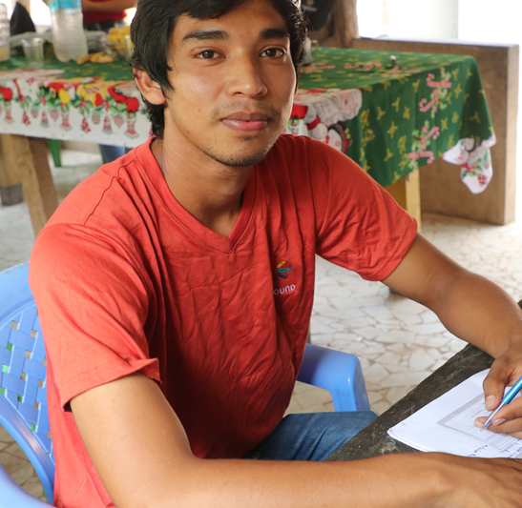
Correspondence Manual

Slide 10
2.1.5 Acknowledgement Letters
Reason for revision: To provide guidance for the new Acknowledgement Letter process in Portal
Unbound-Kansas will request an acknowledgment letter via the Communications page in Portal send a speed letter in most cases when a sponsor makes a contribution of $100 or more. This acknowledgement speed letter communication will request an acknowledgement letter to be sent as soon as the funds are utilized. Please refer to the “Speed Letters” section of this manual for further instructions regarding Acknowledgement Letters.
This will request that the project complete one of the following:
The sponsored member submits an acknowledgement letter after the funds have been used. The letter will share how the funds were spent. If this is not possible, proceed to the second option:
If the sponsored member will not be able to use the funds in the next 60 days, but has a plan for how the funds will be used, please have the sponsored member submit an acknowledgment letter to explain the future use of the funds. If this is not possible, proceed to the third option:

Slide 11
2.1.5 Acknowledgement Letters
3. If there is a problem and/or it will not be possible to utilize the funds or determine a plan for their use in the next 60 days, the project should reply to the request with an approximate timeline for utilizing the funds. When the speed letter team receives this timeline, they will close the initial request. The speed letter team will then monitor the timeline and send a new request for an acknowledgement letter at the time that the timeline indicates the family is going to use the funds. Unbound-Kansas will update the sponsor on the progress until an acknowledgement letter is submitted.
Please create a digital letter in Portal - either a scanned color copy of a handwritten or typed acknowledgement letter and translation (if necessary and if the letter will not be translated in the Translation Module) in response to the acknowledgement letter communication. Please do not send the letter by mail or email. The project should archive the original handwritten letter for a minimum of 12 months.

Slide 12
2.1.5 Acknowledgement Letters
Please do not mention specific dollar or other currency amounts. This type of letter counts as a regular letter and should also include additional, personalized information about the sponsored member.
If a sponsor has recently written the sponsored member and the sponsored member has not yet replied, and if there is a pending acknowledgement letter, it is ok and preferred to reply to the sponsor’s letter in the acknowledgement letter so that it is not necessary to send two separate letters.
If there is no acknowledgement letter communication in Portal, an acknowledgement letter should not be sent. Instead, the project may choose to acknowledge receipt of the funds through the next regular letter the sponsored member writes.

Slide 13
2.2 General Letter-Writing Requirements
Reason for revision: To limit the sharing of information that could facilitate direct communication.
2.2.1 Letter Content
Letters must be personalized and authentic and should be written by the sponsored member whenever possible. A personal letter is essential in strengthening the relationship between sponsor and sponsored and should express the unique personality of each sponsored member.
Sponsored members should not include any usernames, nicknames or names used in social media that could help identify the child.

Slide 14
2.3 Letter Reviews
Reason for revision: To provide guidance on the role of project staff conducting letter reviews in Portal.
Every letter must be reviewed in Portal before it can be submitted to Unbound-Kansas. It is extremely important to identify any issues with letters during this review step because it is often the only point of review before letters will be sent to sponsors. Letters will not necessarily be reviewed for scan quality or content in Kansas before they are sent to sponsors. It is the project’s responsibility to identify and reject unacceptable or duplicate letters.
If a reviewer determines that a letter needs to be rewritten or re-scanned before it can be submitted to Kansas and sent to the sponsor, the reviewer should decline the letter.
The following are examples of when a letter should be declined:
Letter contents
The letter was written to “Dear Sponsor” instead of addressing the letter directly to the sponsor, using the sponsor’s first name

Slide 15
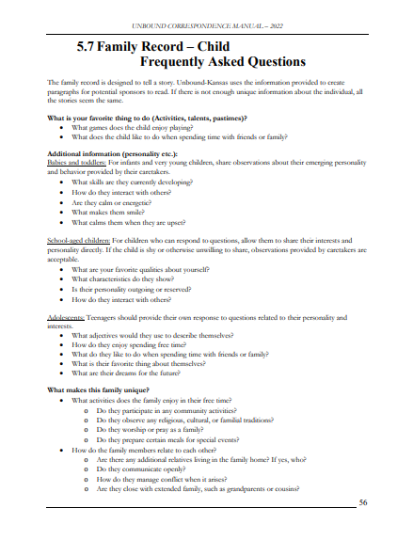
5.7 Family Record – Child Frequently Asked Questions
Reason for revision: To provide guidance for project staff when gathering information for new child records.

Slide 16
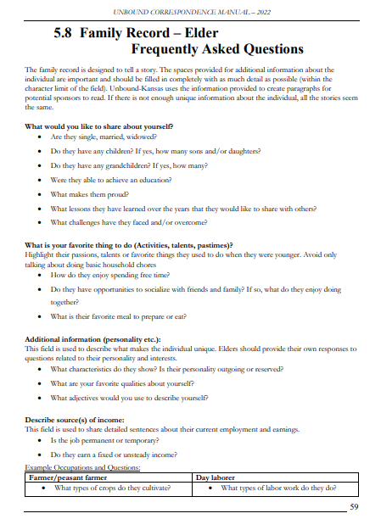
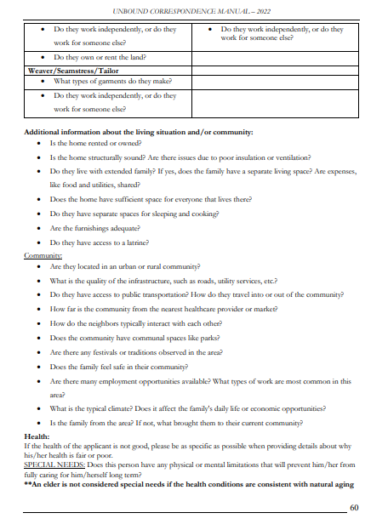
5.8 Family Record – Elder Frequently Asked Questions
Reason for revision: To provide guidance for project staff when gathering information for new elder records.

Slide 17
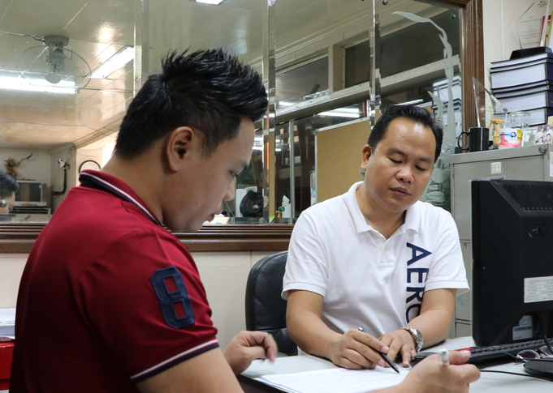
Financial Policies Manual

Slide 18
2.2 Birthday (Fund 20) and Christmas (Fund 25) (Restricted)
Reason for revision: To put more decision making in the hands of families, the preferred method of using these funds is to transfer the intended funds to the individual bank account of the sponsored members. Families who desire a party can choose to pool their personal funds and/or Birthday/Christmas funds to organize parties.

Slide 19
2.7 Livelihood Fund (Fund 70)
Reason for revision: Fund (70) will no longer be used after 2021. Instead, we will used fund (40) Unbound grants. No reclassification will be necessary for prior balances. Projects can use this fund for accounting purposes until the balance is zero, but new grants should be accounted for Fund 70.

Slide 20
Trips Manual

Slide 21
No significant changes in the Trips Manual this year

Slide 22
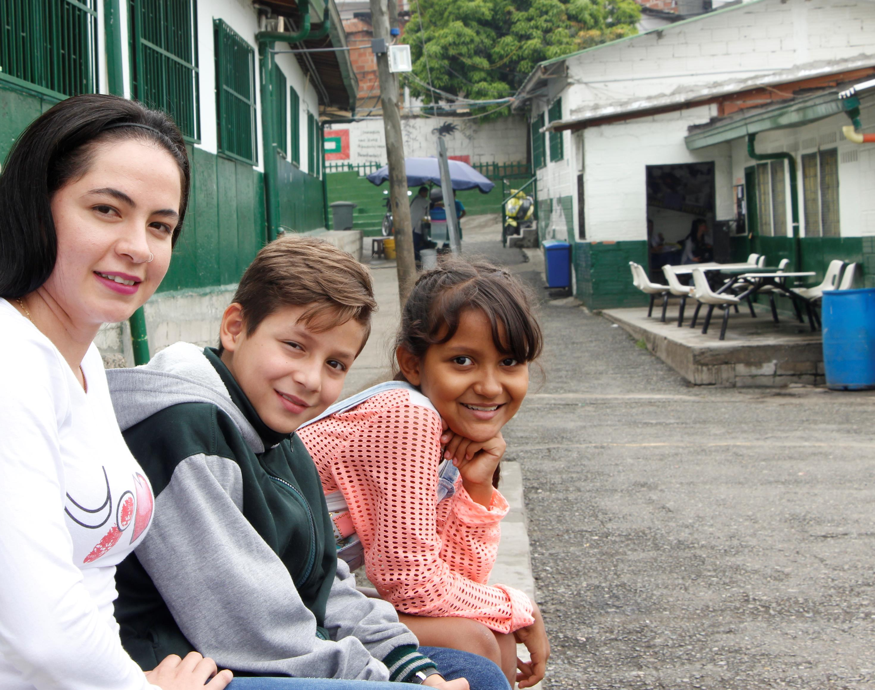
Questions?

