Slide 1
Bienvenidos
Comenzaremos en unos minutos.
Para dificultades técnicas, favor de enviar un mensaje de chat a “Presentadores.”
Debido al formato del seminario, solo los presentadores van a tener acceso a un micrófono. Todos los demás estarán en silencio sin acceso a un micrófono.
Les invitamos enviar sus saludos a todos a través del “Chat.” Elige a “Todos los presentadores y participantes” para que todos puedan ver sus saludos.
Saludos, elige a “Todos los presentadores y participantes”
Notes:
Click on the link to the webinar. When prompted, click “Open Zoom meetings.”
Then click on “Join with Computer Audio.”

Slide 2
Preguntas versus Chat
Favor de enviar sus saludos a través del “Chat.” Elige a “Todos los presentadores y participantes.”
Favor de hacer sus preguntas en la ventana de P&R (Q&A)
Preguntas
Saludos a “Todos los presentadores y participantes.”

Slide 3
Semáforo de eliminación de la Pobreza
Video mensajes
Prioridades Globales del 2023

Slide 4
Manual de Apadrinamiento

Slide 5
2.4.7 Oficinas Sucursales de Unbound (nueva sección)
Razón de la revisión: Nueva sección.
Oficinas sucursales de Unbound se localicen fuera de los EEUU sino pertenecen a la personería jurídica de Unbound y la estructura de Unbound Kansas. Estas oficinas contratan miembros del equipo de la sede central y el personal corresponden directamente a varios departamentos de Unbound Kansas según sus roles y responsabilidades.
Unbound Colombia se encuentra en Medellín, Colombia e incluye miembros de los equipos Programas Internacionales, Finanzas, Mercadeo y Comunicaciones y Apoyo al Padrino.
Unbound Filipinas se encuentra en Manila, Filipinas e incluye personal de los equipos Programas Internacionales y Mercadeo y Comunicaciones.
Notes:
All Unbound staff members are required to take and pass internet security training at least once a year
Projects are required to regularly back up the data stored on project computers (preferably once per week) and store the backup data using an online storage service, such as Microsoft OneDrive or Google Drive, or physical storage at an offsite location.
All software licenses, including for Microsoft Windows, must be legal and still supported by the manufacturer. For example, Windows 7 is no longer supported by Microsoft, so all computers should be updated to a supported version of Windows, or the computers should be replaced by newer ones with newer operating systems. All software should be kept up to date with updates from the manufacturer.
Employees should not use their personal email addresses for their work at Unbound. A separate email address should be used for Unbound purposes only. Email addresses byfor Unbound staff should be administered by the project and should be able to be deactivated by the project to keep information secure. Examples of emails that can be administered by the project are intl.unbound.org email addresses. Examples of emails that cannot be administered by the project are addresses that end in hotmail.com or gmail.com and cannot be used as an Unbound work account. Email accounts ending in intl.unbound.org are available from Unbound Kansas if additional email accounts are needed. All employees are required to have an individual intl.unbound.org email account, which is needed to access the annual security training and, depending on the employee’s role, other Unbound systems.
For more generic email addresses, such as AccountingSubprojectABC@intl.unbound.org, if this account is ever transferred from one employee to another, the password should always be changed when the new employee gains access to the account.
Portal, Abila, Translation Module and Yammer accounts should be specific to one user and should not be shared by multiple users. Passwords for these accounts should only be known by the user to whom they belong and should not be shared with others. Additional accounts are always available from Unbound-Kansas if additional people need access to these systems.
Email accounts that are shared by more than one employee should not be entered as an employee’s email address when registering for Abila, Portal, the Translation Module or Yammer. Email accounts entered for each user for these websites should be specific to the individual.
If an email address for an Abila user changes, Kansas should be notified immediately so the email can be changed in Abila. Email addresses associated with Portal or Translation Module accounts should be updated by each user or the project administrator if any changes are made.
Upon separation of employment of an employee from Unbound, the Kansas regional team should be notified immediately. The individual work email of the departing employee should be inactivated immediately by the project, or the password should be changed so that it can no longer be accessed by the former employee
If the departing employee had access to a more generic email address used by multiple people, such as ProjectCorrespondence@intl.unbound.org, the password to this email should be changed immediately upon the employee’s departure from Unbound.
The Portal Project Admin should remove the roles of the departing employee’s Portal account immediately.

Slide 6
6.4.5.5 Sitio de una ISV
Razón de la revisión: Agregar información y guía sobre viajes necesarios para la ISV dentro del contexto cambiante de salud global.
[Nuevo párrafo]
Tenga en cuenta los riesgos de un viaje largo que viaja fuera de la zona o región en la que vive la familia apadrinada, considere las ventajas y desventajas de acuerdo con la política de protección de miembros apadrinados, las medidas de salud pública vigentes, como las restricciones de viaje y la rapidez con que pueden cambiar. El sitio de visita debe ser donde la familia pueda viajar y regresar a casa el mismo día de la visita. Si esto no es posible, póngase en contacto con un coordinador de ISV ISV@unbound.org. Unbound no lleva a las familias patrocinadas a través de las fronteras internacionales.
Notes:
All Unbound staff members are required to take and pass internet security training at least once a year
Projects are required to regularly back up the data stored on project computers (preferably once per week) and store the backup data using an online storage service, such as Microsoft OneDrive or Google Drive, or physical storage at an offsite location.
All software licenses, including for Microsoft Windows, must be legal and still supported by the manufacturer. For example, Windows 7 is no longer supported by Microsoft, so all computers should be updated to a supported version of Windows, or the computers should be replaced by newer ones with newer operating systems. All software should be kept up to date with updates from the manufacturer.
Employees should not use their personal email addresses for their work at Unbound. A separate email address should be used for Unbound purposes only. Email addresses byfor Unbound staff should be administered by the project and should be able to be deactivated by the project to keep information secure. Examples of emails that can be administered by the project are intl.unbound.org email addresses. Examples of emails that cannot be administered by the project are addresses that end in hotmail.com or gmail.com and cannot be used as an Unbound work account. Email accounts ending in intl.unbound.org are available from Unbound Kansas if additional email accounts are needed. All employees are required to have an individual intl.unbound.org email account, which is needed to access the annual security training and, depending on the employee’s role, other Unbound systems.
For more generic email addresses, such as AccountingSubprojectABC@intl.unbound.org, if this account is ever transferred from one employee to another, the password should always be changed when the new employee gains access to the account.
Portal, Abila, Translation Module and Yammer accounts should be specific to one user and should not be shared by multiple users. Passwords for these accounts should only be known by the user to whom they belong and should not be shared with others. Additional accounts are always available from Unbound-Kansas if additional people need access to these systems.
Email accounts that are shared by more than one employee should not be entered as an employee’s email address when registering for Abila, Portal, the Translation Module or Yammer. Email accounts entered for each user for these websites should be specific to the individual.
If an email address for an Abila user changes, Kansas should be notified immediately so the email can be changed in Abila. Email addresses associated with Portal or Translation Module accounts should be updated by each user or the project administrator if any changes are made.
Upon separation of employment of an employee from Unbound, the Kansas regional team should be notified immediately. The individual work email of the departing employee should be inactivated immediately by the project, or the password should be changed so that it can no longer be accessed by the former employee
If the departing employee had access to a more generic email address used by multiple people, such as ProjectCorrespondence@intl.unbound.org, the password to this email should be changed immediately upon the employee’s departure from Unbound.
The Portal Project Admin should remove the roles of the departing employee’s Portal account immediately.

Slide 7
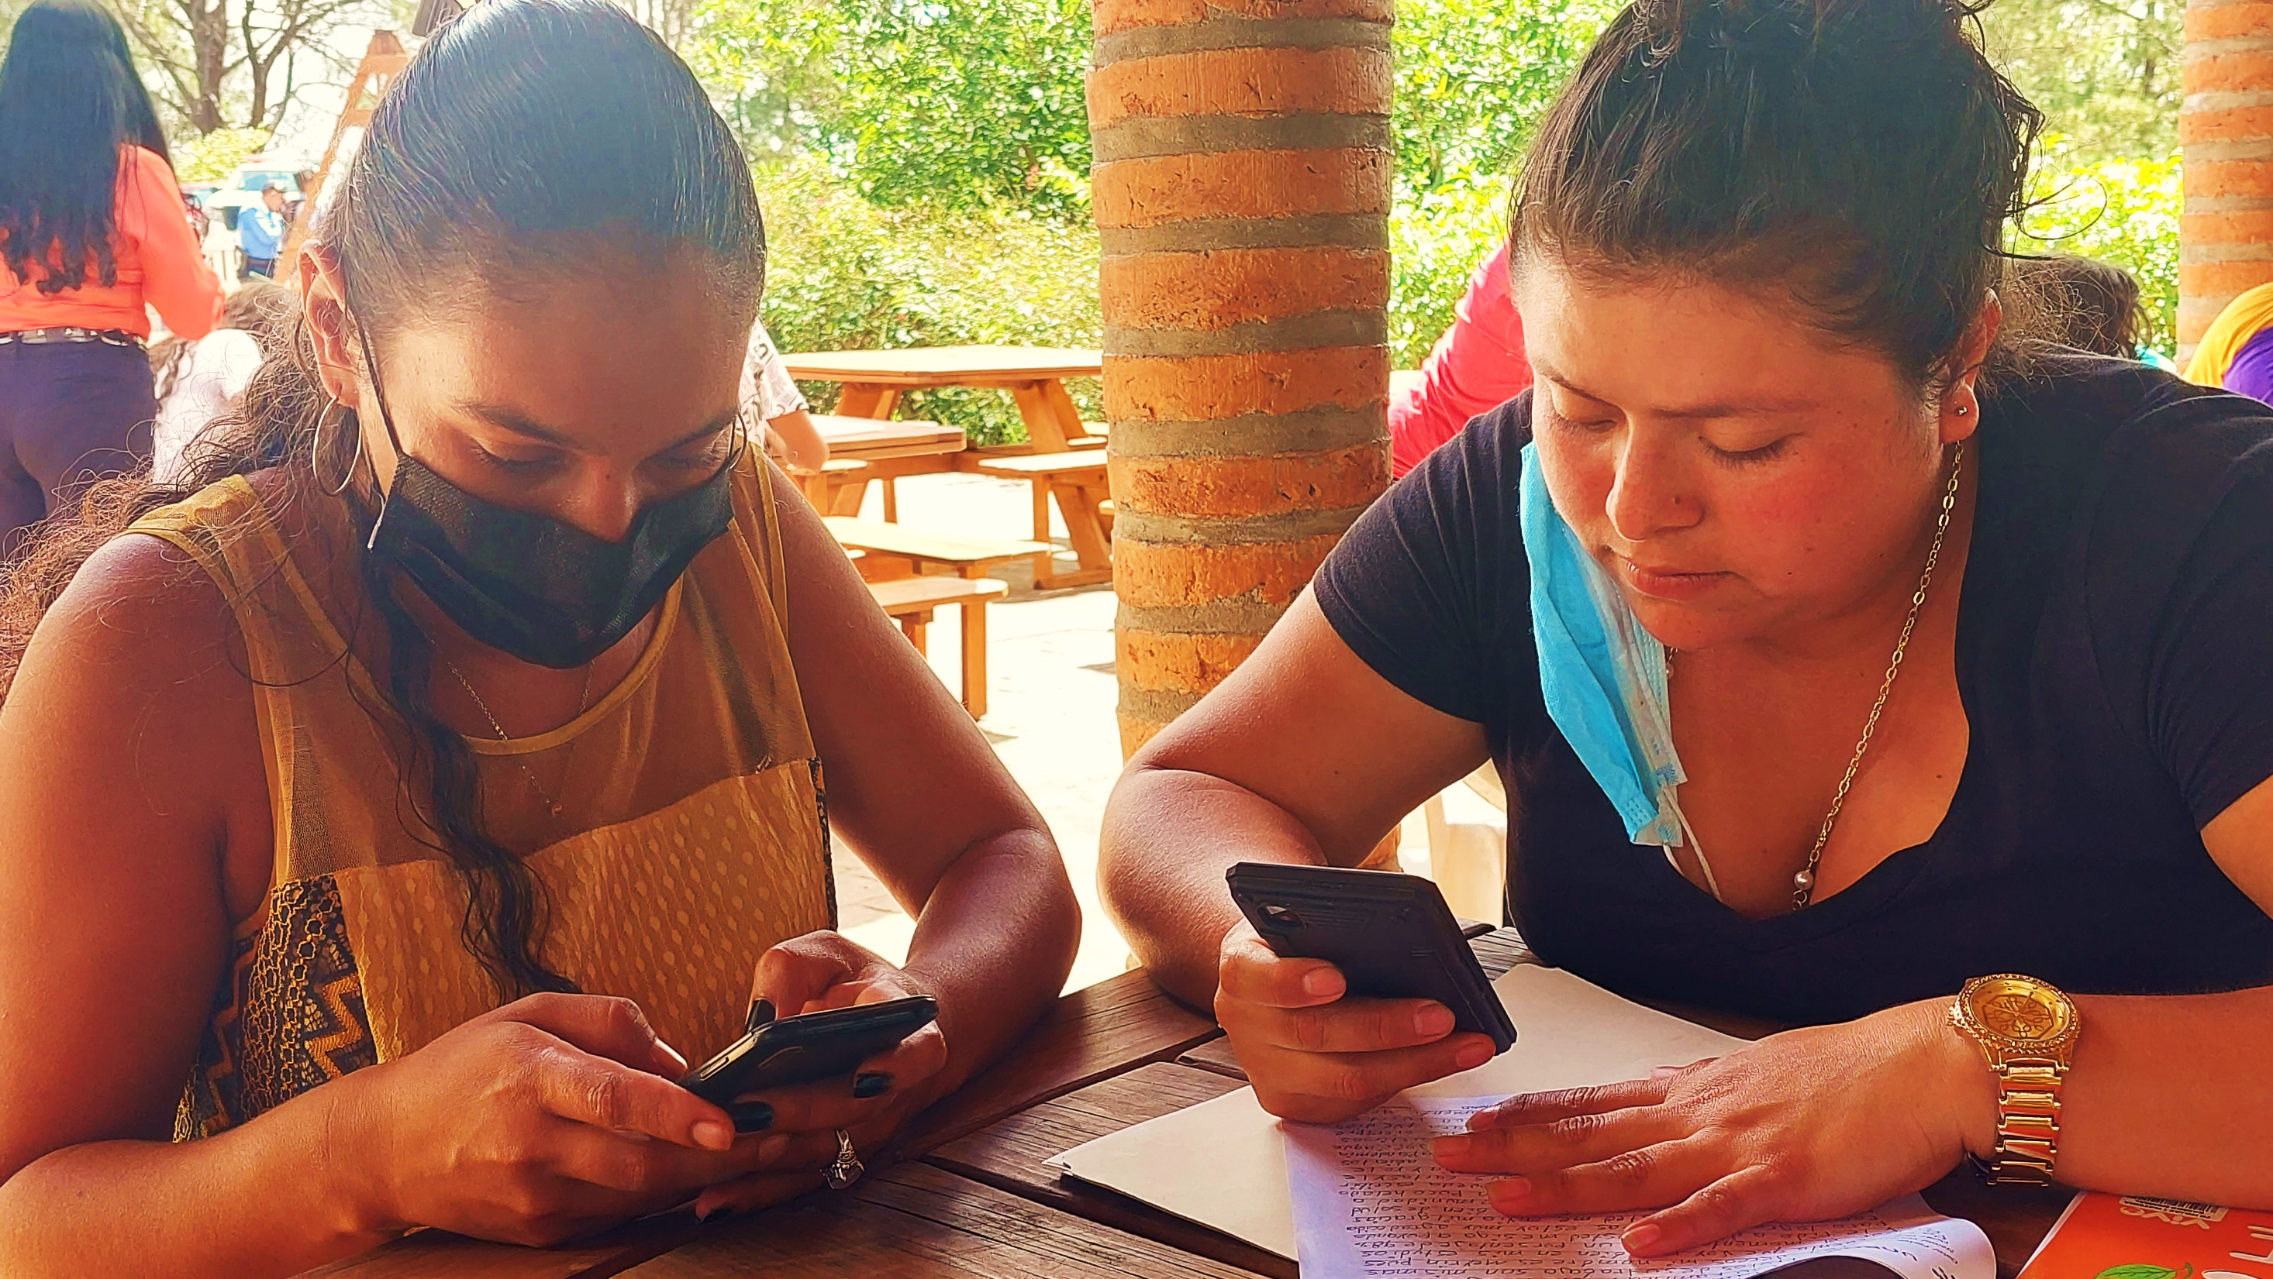
Manual de Correspondencia

Slide 8
2.1 Video mensajes (nueva sección)
Razón de la revisión: nueva sección
Favor de revisar la sección 2.1 por completo en el Manual de Correspondencia.
Notes:
All Unbound staff members are required to take and pass internet security training at least once a year
Projects are required to regularly back up the data stored on project computers (preferably once per week) and store the backup data using an online storage service, such as Microsoft OneDrive or Google Drive, or physical storage at an offsite location.
All software licenses, including for Microsoft Windows, must be legal and still supported by the manufacturer. For example, Windows 7 is no longer supported by Microsoft, so all computers should be updated to a supported version of Windows, or the computers should be replaced by newer ones with newer operating systems. All software should be kept up to date with updates from the manufacturer.
Employees should not use their personal email addresses for their work at Unbound. A separate email address should be used for Unbound purposes only. Email addresses byfor Unbound staff should be administered by the project and should be able to be deactivated by the project to keep information secure. Examples of emails that can be administered by the project are intl.unbound.org email addresses. Examples of emails that cannot be administered by the project are addresses that end in hotmail.com or gmail.com and cannot be used as an Unbound work account. Email accounts ending in intl.unbound.org are available from Unbound Kansas if additional email accounts are needed. All employees are required to have an individual intl.unbound.org email account, which is needed to access the annual security training and, depending on the employee’s role, other Unbound systems.
For more generic email addresses, such as AccountingSubprojectABC@intl.unbound.org, if this account is ever transferred from one employee to another, the password should always be changed when the new employee gains access to the account.
Portal, Abila, Translation Module and Yammer accounts should be specific to one user and should not be shared by multiple users. Passwords for these accounts should only be known by the user to whom they belong and should not be shared with others. Additional accounts are always available from Unbound-Kansas if additional people need access to these systems.
Email accounts that are shared by more than one employee should not be entered as an employee’s email address when registering for Abila, Portal, the Translation Module or Yammer. Email accounts entered for each user for these websites should be specific to the individual.
If an email address for an Abila user changes, Kansas should be notified immediately so the email can be changed in Abila. Email addresses associated with Portal or Translation Module accounts should be updated by each user or the project administrator if any changes are made.
Upon separation of employment of an employee from Unbound, the Kansas regional team should be notified immediately. The individual work email of the departing employee should be inactivated immediately by the project, or the password should be changed so that it can no longer be accessed by the former employee
If the departing employee had access to a more generic email address used by multiple people, such as ProjectCorrespondence@intl.unbound.org, the password to this email should be changed immediately upon the employee’s departure from Unbound.
The Portal Project Admin should remove the roles of the departing employee’s Portal account immediately.

Slide 9
2.2.2 Cartas
Razón de la revisión: Cambio a la meta principal de cartas de apadrinados que reciben cartas de sus padrinos.
Todo beneficiado de Unbound que tiene un padrino debe enviar una carta al menos cada seis meses. Los beneficiados que se encuentran en “cambio de padrino” o en “beneficios hasta” no deben enviar cartas.
Si un apadrinado recibe correspondencia de su padrino, la meta principal de las cartas/videos es continuar una conversación con el padrino. Los apadrinados deben contestar la última carta del padrino, reconocer el contenido y responder a las preguntas del padrino.
Las cartas también deben incluir información actual sobre la vida del apadrinado y sobre su meta con Unbound. Pueden incluir información sobre la familia, intereses, la comunidad, la cultura, vida diaria, desempeño académico, nivel estudiantil actual, materias favoritas en la escuela, ambiciones académicas, actividades extracurriculares, el estado general de salud, pasatiempos (hobbies) o cualquier otro asunto de interés. Si es posible, cuando la carta se sube de forma digital, se recomienda incluir fotos del apadrinado. Los apadrinados que no reciben correspondencia de sus padrinos pueden involucrar al padrino al hacerle preguntas acerca de su vida.
Notes:
All Unbound staff members are required to take and pass internet security training at least once a year
Projects are required to regularly back up the data stored on project computers (preferably once per week) and store the backup data using an online storage service, such as Microsoft OneDrive or Google Drive, or physical storage at an offsite location.
All software licenses, including for Microsoft Windows, must be legal and still supported by the manufacturer. For example, Windows 7 is no longer supported by Microsoft, so all computers should be updated to a supported version of Windows, or the computers should be replaced by newer ones with newer operating systems. All software should be kept up to date with updates from the manufacturer.
Employees should not use their personal email addresses for their work at Unbound. A separate email address should be used for Unbound purposes only. Email addresses byfor Unbound staff should be administered by the project and should be able to be deactivated by the project to keep information secure. Examples of emails that can be administered by the project are intl.unbound.org email addresses. Examples of emails that cannot be administered by the project are addresses that end in hotmail.com or gmail.com and cannot be used as an Unbound work account. Email accounts ending in intl.unbound.org are available from Unbound Kansas if additional email accounts are needed. All employees are required to have an individual intl.unbound.org email account, which is needed to access the annual security training and, depending on the employee’s role, other Unbound systems.
For more generic email addresses, such as AccountingSubprojectABC@intl.unbound.org, if this account is ever transferred from one employee to another, the password should always be changed when the new employee gains access to the account.
Portal, Abila, Translation Module and Yammer accounts should be specific to one user and should not be shared by multiple users. Passwords for these accounts should only be known by the user to whom they belong and should not be shared with others. Additional accounts are always available from Unbound-Kansas if additional people need access to these systems.
Email accounts that are shared by more than one employee should not be entered as an employee’s email address when registering for Abila, Portal, the Translation Module or Yammer. Email accounts entered for each user for these websites should be specific to the individual.
If an email address for an Abila user changes, Kansas should be notified immediately so the email can be changed in Abila. Email addresses associated with Portal or Translation Module accounts should be updated by each user or the project administrator if any changes are made.
Upon separation of employment of an employee from Unbound, the Kansas regional team should be notified immediately. The individual work email of the departing employee should be inactivated immediately by the project, or the password should be changed so that it can no longer be accessed by the former employee
If the departing employee had access to a more generic email address used by multiple people, such as ProjectCorrespondence@intl.unbound.org, the password to this email should be changed immediately upon the employee’s departure from Unbound.
The Portal Project Admin should remove the roles of the departing employee’s Portal account immediately.

Slide 10
3.2 Instrucciones sobre las fotos anuales
Razón de la revisión: Incluir la recomendación para cuando no es posible tomar una foto digna de un apadrinado
Lineamientos de las fotos:
[punto nuevo]
En casos especiales, puede que sea imposible capturar una foto digna de un individuo debido a problemas de salud. En estos casos, consulte con su especialista regional para determinar si se puede aceptar una foto alternativa.
Notes:
All Unbound staff members are required to take and pass internet security training at least once a year
Projects are required to regularly back up the data stored on project computers (preferably once per week) and store the backup data using an online storage service, such as Microsoft OneDrive or Google Drive, or physical storage at an offsite location.
All software licenses, including for Microsoft Windows, must be legal and still supported by the manufacturer. For example, Windows 7 is no longer supported by Microsoft, so all computers should be updated to a supported version of Windows, or the computers should be replaced by newer ones with newer operating systems. All software should be kept up to date with updates from the manufacturer.
Employees should not use their personal email addresses for their work at Unbound. A separate email address should be used for Unbound purposes only. Email addresses byfor Unbound staff should be administered by the project and should be able to be deactivated by the project to keep information secure. Examples of emails that can be administered by the project are intl.unbound.org email addresses. Examples of emails that cannot be administered by the project are addresses that end in hotmail.com or gmail.com and cannot be used as an Unbound work account. Email accounts ending in intl.unbound.org are available from Unbound Kansas if additional email accounts are needed. All employees are required to have an individual intl.unbound.org email account, which is needed to access the annual security training and, depending on the employee’s role, other Unbound systems.
For more generic email addresses, such as AccountingSubprojectABC@intl.unbound.org, if this account is ever transferred from one employee to another, the password should always be changed when the new employee gains access to the account.
Portal, Abila, Translation Module and Yammer accounts should be specific to one user and should not be shared by multiple users. Passwords for these accounts should only be known by the user to whom they belong and should not be shared with others. Additional accounts are always available from Unbound-Kansas if additional people need access to these systems.
Email accounts that are shared by more than one employee should not be entered as an employee’s email address when registering for Abila, Portal, the Translation Module or Yammer. Email accounts entered for each user for these websites should be specific to the individual.
If an email address for an Abila user changes, Kansas should be notified immediately so the email can be changed in Abila. Email addresses associated with Portal or Translation Module accounts should be updated by each user or the project administrator if any changes are made.
Upon separation of employment of an employee from Unbound, the Kansas regional team should be notified immediately. The individual work email of the departing employee should be inactivated immediately by the project, or the password should be changed so that it can no longer be accessed by the former employee
If the departing employee had access to a more generic email address used by multiple people, such as ProjectCorrespondence@intl.unbound.org, the password to this email should be changed immediately upon the employee’s departure from Unbound.
The Portal Project Admin should remove the roles of the departing employee’s Portal account immediately.

Slide 11
4.1 Notas Rápidas
Razón de la revisión: Cambio para permitir que las cartas escritas en respuesta a una nota rápida sean enviadas a través de Portal
Cuando se responde una nota rápida:
Cuando responda una nota rápida, por favor conteste por correo electrónico el mensaje original de la nota rápida y adjunte cualquier documentación solicitada. Esto asegura que el número de la nota rápida se incluya en el asunto o cuerpo del correo electrónico.
Favor dar prioridad las notas rápidas marcadas “urgente”.
Cuando un apadrinado escribe una carta al padrino o madrina en respuesta a una nota rápida, por favor subir la carta por Portal y responder a la nota rápida indicando el número del lote o adjunte una copia de la carta a color escaneada en alta calidad o una carta escrita a computadora y la traducción (si se requiere). Favor no incluir las palabras “nota rápida” en las cartas del miembro apadrinado que son enviadas en respuesta a la pregunta de la nota rápida. Este es un término para uso interno de Unbound que no se utiliza con los padrinos.
Notes:
All Unbound staff members are required to take and pass internet security training at least once a year
Projects are required to regularly back up the data stored on project computers (preferably once per week) and store the backup data using an online storage service, such as Microsoft OneDrive or Google Drive, or physical storage at an offsite location.
All software licenses, including for Microsoft Windows, must be legal and still supported by the manufacturer. For example, Windows 7 is no longer supported by Microsoft, so all computers should be updated to a supported version of Windows, or the computers should be replaced by newer ones with newer operating systems. All software should be kept up to date with updates from the manufacturer.
Employees should not use their personal email addresses for their work at Unbound. A separate email address should be used for Unbound purposes only. Email addresses byfor Unbound staff should be administered by the project and should be able to be deactivated by the project to keep information secure. Examples of emails that can be administered by the project are intl.unbound.org email addresses. Examples of emails that cannot be administered by the project are addresses that end in hotmail.com or gmail.com and cannot be used as an Unbound work account. Email accounts ending in intl.unbound.org are available from Unbound Kansas if additional email accounts are needed. All employees are required to have an individual intl.unbound.org email account, which is needed to access the annual security training and, depending on the employee’s role, other Unbound systems.
For more generic email addresses, such as AccountingSubprojectABC@intl.unbound.org, if this account is ever transferred from one employee to another, the password should always be changed when the new employee gains access to the account.
Portal, Abila, Translation Module and Yammer accounts should be specific to one user and should not be shared by multiple users. Passwords for these accounts should only be known by the user to whom they belong and should not be shared with others. Additional accounts are always available from Unbound-Kansas if additional people need access to these systems.
Email accounts that are shared by more than one employee should not be entered as an employee’s email address when registering for Abila, Portal, the Translation Module or Yammer. Email accounts entered for each user for these websites should be specific to the individual.
If an email address for an Abila user changes, Kansas should be notified immediately so the email can be changed in Abila. Email addresses associated with Portal or Translation Module accounts should be updated by each user or the project administrator if any changes are made.
Upon separation of employment of an employee from Unbound, the Kansas regional team should be notified immediately. The individual work email of the departing employee should be inactivated immediately by the project, or the password should be changed so that it can no longer be accessed by the former employee
If the departing employee had access to a more generic email address used by multiple people, such as ProjectCorrespondence@intl.unbound.org, the password to this email should be changed immediately upon the employee’s departure from Unbound.
The Portal Project Admin should remove the roles of the departing employee’s Portal account immediately.

Slide 12
4.2.2 Jóvenes en Cambio de Padrino
Razón de la revisión: Cambio de política para solicitar que todos los apadrinados en estado de Beneficios hasta tengan fecha de retiro en la primera mitad del mes para asegurar que el equipo de retiros en Kansas tenga tiempo de procesar su retiro en el mes indicado.
OPCIÓN 2: Mantener el joven en cambio de padrino en la lista de beneficiados hasta una fecha específica (aparecerá como “BENEFICIOS HASTA [fecha]”). Se requiere esta fecha y es la fecha en que Unbound- Kansas retirará automáticamente al estudiante.
Esta opción se debe elegir para estudiantes que van a dejar el programa en los próximos 24 meses.
Como con todas las personas en la lista de beneficiados en cambio de padrino, el proyecto continuará proporcionando beneficios al joven en estado “beneficios hasta” hasta que Unbound- Kansas lo retire en la fecha especificada.
Para indicar la Opción 2, por favor enviar una página de salida a través de Portal, cambie la fecha de retiro a la fecha futura en que el joven completará sus estudios. Por favor, asegúrese de establecer una fecha de retiro para antes del día 15 del mes para apoyar los procesos en Kansas.
Notes:
All Unbound staff members are required to take and pass internet security training at least once a year
Projects are required to regularly back up the data stored on project computers (preferably once per week) and store the backup data using an online storage service, such as Microsoft OneDrive or Google Drive, or physical storage at an offsite location.
All software licenses, including for Microsoft Windows, must be legal and still supported by the manufacturer. For example, Windows 7 is no longer supported by Microsoft, so all computers should be updated to a supported version of Windows, or the computers should be replaced by newer ones with newer operating systems. All software should be kept up to date with updates from the manufacturer.
Employees should not use their personal email addresses for their work at Unbound. A separate email address should be used for Unbound purposes only. Email addresses byfor Unbound staff should be administered by the project and should be able to be deactivated by the project to keep information secure. Examples of emails that can be administered by the project are intl.unbound.org email addresses. Examples of emails that cannot be administered by the project are addresses that end in hotmail.com or gmail.com and cannot be used as an Unbound work account. Email accounts ending in intl.unbound.org are available from Unbound Kansas if additional email accounts are needed. All employees are required to have an individual intl.unbound.org email account, which is needed to access the annual security training and, depending on the employee’s role, other Unbound systems.
For more generic email addresses, such as AccountingSubprojectABC@intl.unbound.org, if this account is ever transferred from one employee to another, the password should always be changed when the new employee gains access to the account.
Portal, Abila, Translation Module and Yammer accounts should be specific to one user and should not be shared by multiple users. Passwords for these accounts should only be known by the user to whom they belong and should not be shared with others. Additional accounts are always available from Unbound-Kansas if additional people need access to these systems.
Email accounts that are shared by more than one employee should not be entered as an employee’s email address when registering for Abila, Portal, the Translation Module or Yammer. Email accounts entered for each user for these websites should be specific to the individual.
If an email address for an Abila user changes, Kansas should be notified immediately so the email can be changed in Abila. Email addresses associated with Portal or Translation Module accounts should be updated by each user or the project administrator if any changes are made.
Upon separation of employment of an employee from Unbound, the Kansas regional team should be notified immediately. The individual work email of the departing employee should be inactivated immediately by the project, or the password should be changed so that it can no longer be accessed by the former employee
If the departing employee had access to a more generic email address used by multiple people, such as ProjectCorrespondence@intl.unbound.org, the password to this email should be changed immediately upon the employee’s departure from Unbound.
The Portal Project Admin should remove the roles of the departing employee’s Portal account immediately.

Slide 13
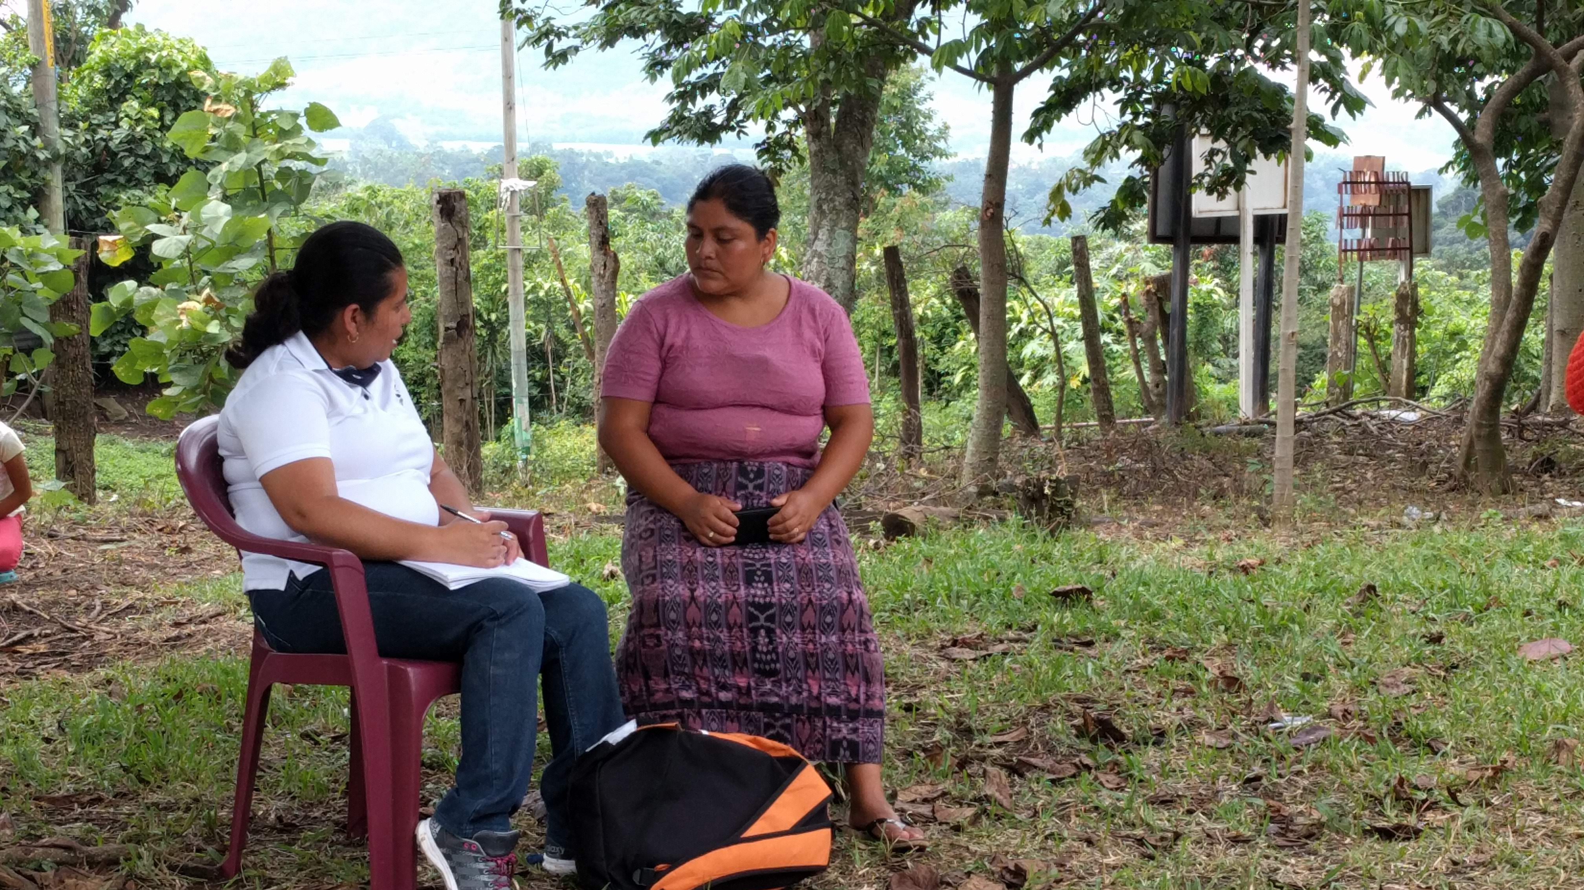
Manual de Políticas Financieras

Slide 14
11.1 Auditoria Externa
Razón de la revisión: Clarificar que el auditor externo no debe ayudar con la preparación de informes que el proyecto presenta al gobierno. Esto va en contra de los principios de independencia del auditor externo.
Las auditorías externas son las auditorias llevadas a cabo por firmas de auditoría independientes ajenas a Kansas. Kansas recomienda que los proyectos sean auditados anualmente por firmas de auditoría locales para revisar la contabilidad del proyecto y asegurar que cumplen con leyes locales.
Las auditorías iniciadas por el proyecto deben revisar los registros financieros para determinar si el auditor puede dar fe de que los libros reflejan una declaración de situación financiera materialmente precisa. El auditor externo también a menudo ayuda con la preparación de informes financieros que se presentarán al gobierno.
Los auditores externos deberán ser rotados de acuerdo con las regulaciones locales del proyecto. En caso de no existir regulación, el proyecto deberá hacer cambio de auditores externos cada 3-5 años.
El reporte de una auditoría local será presentado por el auditor o bien al proyecto o bien a la Junta de Consejo del proyecto. El proyecto debe compartir el informe con Unbound-Kansas, junto con cualquier medida tomada para implementar las recomendaciones del auditor.
Notes:
All Unbound staff members are required to take and pass internet security training at least once a year
Projects are required to regularly back up the data stored on project computers (preferably once per week) and store the backup data using an online storage service, such as Microsoft OneDrive or Google Drive, or physical storage at an offsite location.
All software licenses, including for Microsoft Windows, must be legal and still supported by the manufacturer. For example, Windows 7 is no longer supported by Microsoft, so all computers should be updated to a supported version of Windows, or the computers should be replaced by newer ones with newer operating systems. All software should be kept up to date with updates from the manufacturer.
Employees should not use their personal email addresses for their work at Unbound. A separate email address should be used for Unbound purposes only. Email addresses byfor Unbound staff should be administered by the project and should be able to be deactivated by the project to keep information secure. Examples of emails that can be administered by the project are intl.unbound.org email addresses. Examples of emails that cannot be administered by the project are addresses that end in hotmail.com or gmail.com and cannot be used as an Unbound work account. Email accounts ending in intl.unbound.org are available from Unbound Kansas if additional email accounts are needed. All employees are required to have an individual intl.unbound.org email account, which is needed to access the annual security training and, depending on the employee’s role, other Unbound systems.
For more generic email addresses, such as AccountingSubprojectABC@intl.unbound.org, if this account is ever transferred from one employee to another, the password should always be changed when the new employee gains access to the account.
Portal, Abila, Translation Module and Yammer accounts should be specific to one user and should not be shared by multiple users. Passwords for these accounts should only be known by the user to whom they belong and should not be shared with others. Additional accounts are always available from Unbound-Kansas if additional people need access to these systems.
Email accounts that are shared by more than one employee should not be entered as an employee’s email address when registering for Abila, Portal, the Translation Module or Yammer. Email accounts entered for each user for these websites should be specific to the individual.
If an email address for an Abila user changes, Kansas should be notified immediately so the email can be changed in Abila. Email addresses associated with Portal or Translation Module accounts should be updated by each user or the project administrator if any changes are made.
Upon separation of employment of an employee from Unbound, the Kansas regional team should be notified immediately. The individual work email of the departing employee should be inactivated immediately by the project, or the password should be changed so that it can no longer be accessed by the former employee
If the departing employee had access to a more generic email address used by multiple people, such as ProjectCorrespondence@intl.unbound.org, the password to this email should be changed immediately upon the employee’s departure from Unbound.
The Portal Project Admin should remove the roles of the departing employee’s Portal account immediately.

Slide 15
13 Guia para la Agrupación de Cuentas de GL y Códigos de Depto/Programa
Razón de la revisión: Se agrego un nuevo departamento (Depto. 150). Se puede utilizar este departamento en los casos en los que la norma del país establezca un criterio de calificación de los gastos, administrativos y de programa, diferente al que establece Unbound-Kansas.
Notes:
All Unbound staff members are required to take and pass internet security training at least once a year
Projects are required to regularly back up the data stored on project computers (preferably once per week) and store the backup data using an online storage service, such as Microsoft OneDrive or Google Drive, or physical storage at an offsite location.
All software licenses, including for Microsoft Windows, must be legal and still supported by the manufacturer. For example, Windows 7 is no longer supported by Microsoft, so all computers should be updated to a supported version of Windows, or the computers should be replaced by newer ones with newer operating systems. All software should be kept up to date with updates from the manufacturer.
Employees should not use their personal email addresses for their work at Unbound. A separate email address should be used for Unbound purposes only. Email addresses byfor Unbound staff should be administered by the project and should be able to be deactivated by the project to keep information secure. Examples of emails that can be administered by the project are intl.unbound.org email addresses. Examples of emails that cannot be administered by the project are addresses that end in hotmail.com or gmail.com and cannot be used as an Unbound work account. Email accounts ending in intl.unbound.org are available from Unbound Kansas if additional email accounts are needed. All employees are required to have an individual intl.unbound.org email account, which is needed to access the annual security training and, depending on the employee’s role, other Unbound systems.
For more generic email addresses, such as AccountingSubprojectABC@intl.unbound.org, if this account is ever transferred from one employee to another, the password should always be changed when the new employee gains access to the account.
Portal, Abila, Translation Module and Yammer accounts should be specific to one user and should not be shared by multiple users. Passwords for these accounts should only be known by the user to whom they belong and should not be shared with others. Additional accounts are always available from Unbound-Kansas if additional people need access to these systems.
Email accounts that are shared by more than one employee should not be entered as an employee’s email address when registering for Abila, Portal, the Translation Module or Yammer. Email accounts entered for each user for these websites should be specific to the individual.
If an email address for an Abila user changes, Kansas should be notified immediately so the email can be changed in Abila. Email addresses associated with Portal or Translation Module accounts should be updated by each user or the project administrator if any changes are made.
Upon separation of employment of an employee from Unbound, the Kansas regional team should be notified immediately. The individual work email of the departing employee should be inactivated immediately by the project, or the password should be changed so that it can no longer be accessed by the former employee
If the departing employee had access to a more generic email address used by multiple people, such as ProjectCorrespondence@intl.unbound.org, the password to this email should be changed immediately upon the employee’s departure from Unbound.
The Portal Project Admin should remove the roles of the departing employee’s Portal account immediately.

Slide 16
Manual de Becas-Servicio
Sin cambios significativos

Slide 17
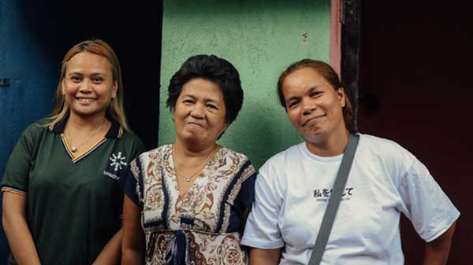
Manual de Viajes
Sin cambios significativos

Slide 18
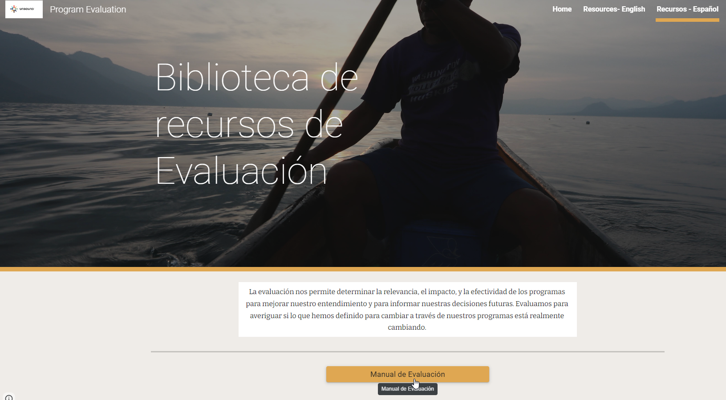
Manual de Evaluación
Versión actualizada en el sitio web de evaluación del programa

Slide 19
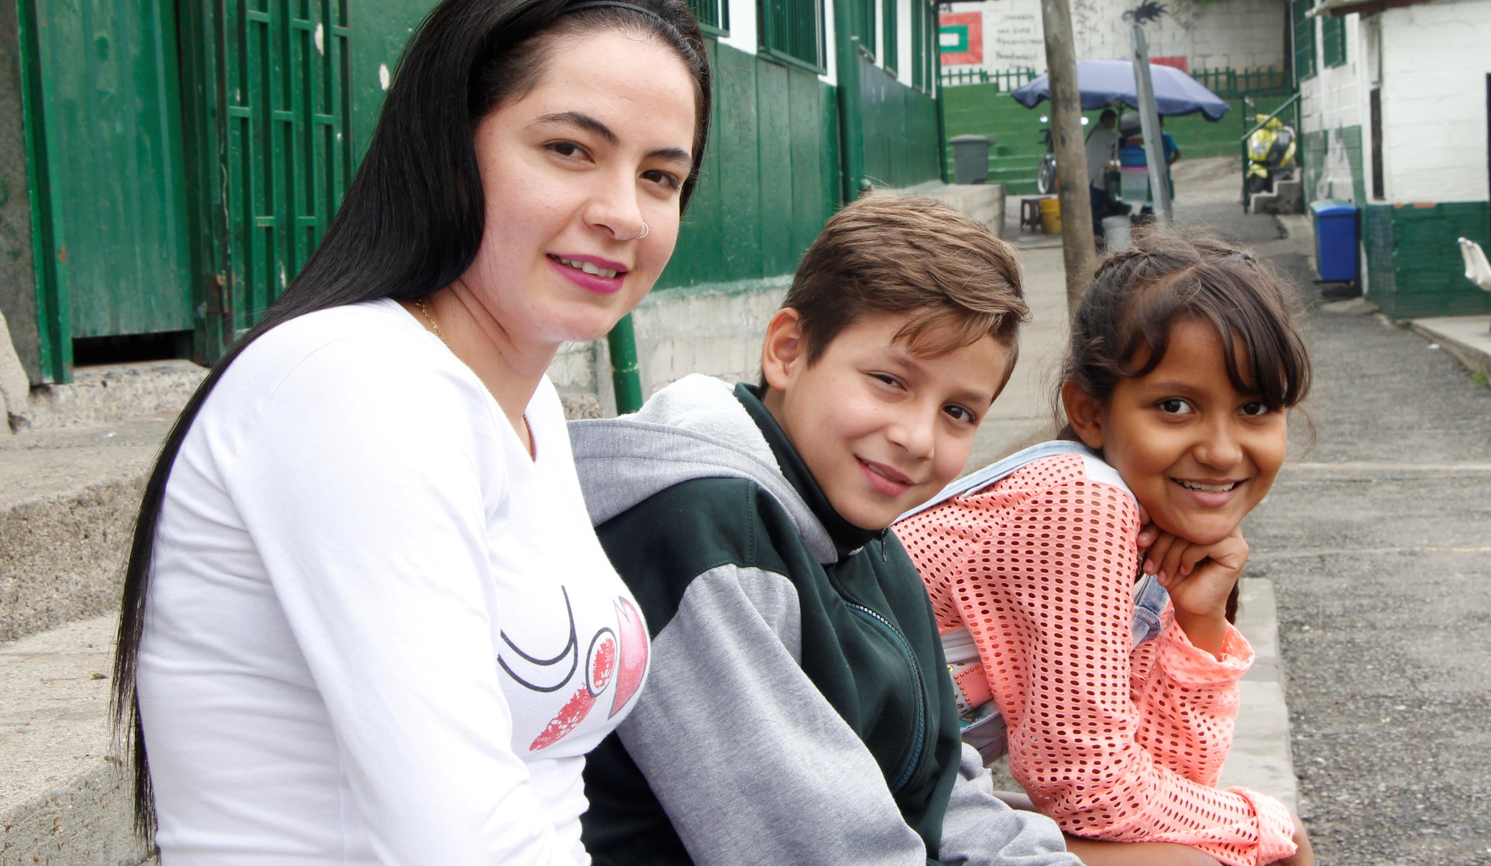
¿Preguntas?

