Slide 1
Welcome!
We will begin in a few minutes
For greetings: Please use the “Chat” feature. Choose “All Panelists and attendees”
For questions: Please type your questions in the Q&A window on the bottom of your screen.

Slide 2
Poverty Stoplight
Video messages
2023 Global Priorities

Slide 3
Sponsorship Manual

Slide 4
2.4.7 Unbound Branch Offices
Reason for revision: Clarify new aspect of Unbound organizational structure
Unbound branch offices are located outside of the United States but are structurally part of Unbound-Kansas. These offices employ members of the Unbound headquarters team and staff report to different Unbound-Kansas departments according to their roles and responsibilities.
Unbound Colombia is located in Medellín, Colombia and includes members of the International Programs, Finance, Marketing & Communications, and Sponsor Support teams.
Unbound Philippines is located in Manila, Philippines and employs members of the International Programs and Marketing & Communications teams.

Slide 5
6.4.5.5 Location of an ISV
Reason for revision: Addition of guidance on travel required for an ISV in our changing global health and political contexts.
[Added paragraph]
Keep in mind the risks of a long trip that travels outside of the zone or region that the sponsored family lives, consider the advantages and disadvantages according to the sponsored member protection policy, public health measures in effect, such as travel restrictions and how quickly they can change. The visit site should be where the family can travel to and return home from on the same day as the visit. If this is not possible, contact an ISV coordinator ISV@unbound.org. Unbound does not take sponsored families across international borders.

Slide 6
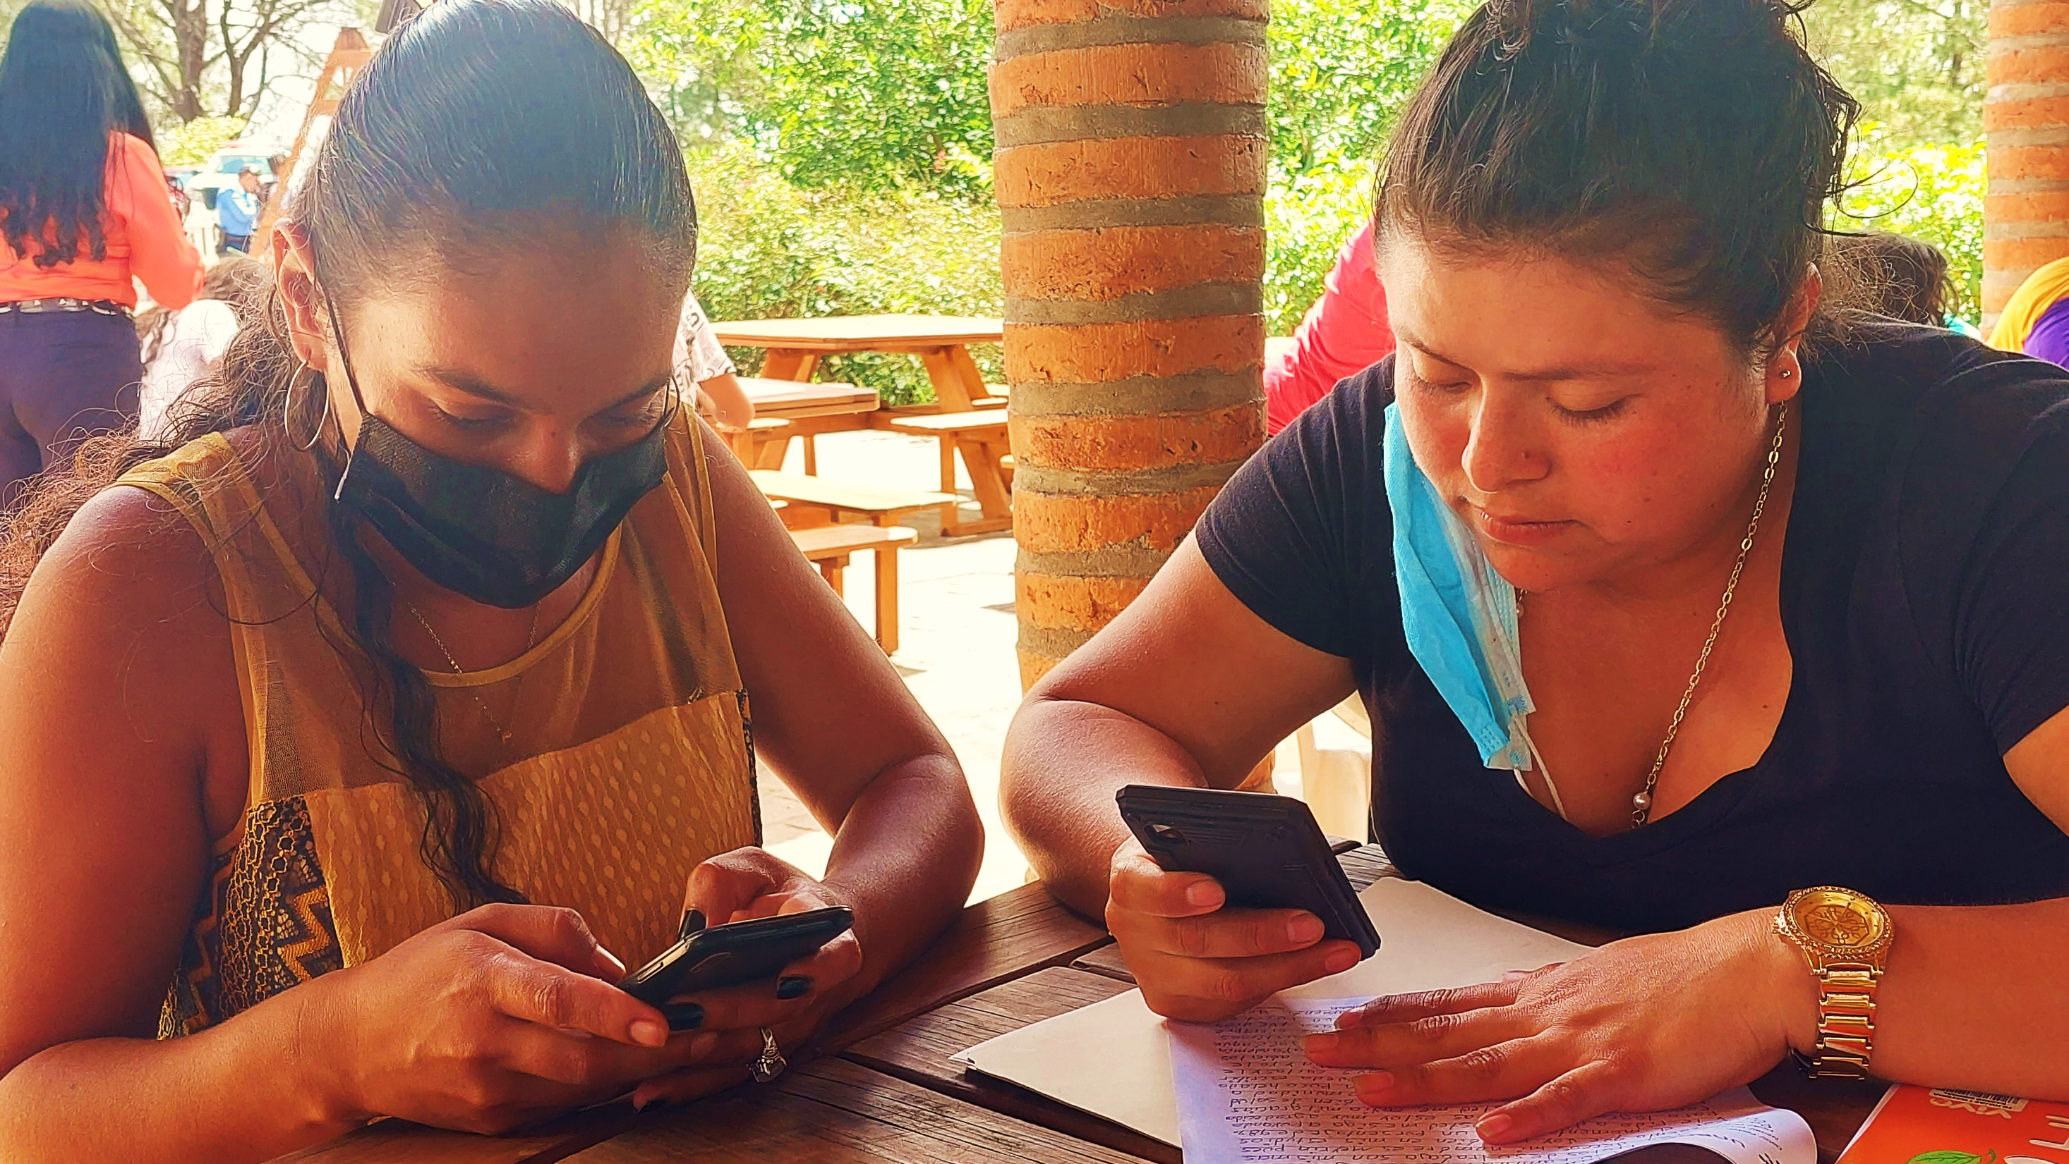
Correspondence Manual

Slide 7
2.1 Video Messages
Reason for revision: New section
[Please review section 2.1 in its entirety in the Correspondence Manual]

Slide 8
2.2.2 Letters
Reason for revision: Change to the primary goal of correspondence from sponsored members who receive correspondence from their sponsor.
Every Unbound beneficiary with a sponsor should send a letter at least every six months. Letters are not required for individuals who are in “Change of Sponsor” or “Benefits Through” status.
If a sponsored member receives mail from their sponsor, the primary goal of letters/videos is to continue a conversation with the sponsor. Sponsored members should reply to sponsor’s most recent letter(s) and should respond to any content or questions from the sponsor.
Letters should also include current information about the life of the sponsored member and about his/her goal. Letters may include information about their family, interests, community, culture, daily life, academic performance, current grade level, favorite subjects in school, academic ambitions, extracurricular activities, general health status, hobbies, or any other items of interest. If the letter is submitted in a typed format, photos should be included as often as possible. Sponsored members who do not receive mail from their sponsors should engage the sponsor by asking questions about the sponsor’s life.

Slide 9
3.2 Annual Photo Guidelines
Reason for revision: Add guidance for when it is not possible to take a dignified photo of a sponsored member.
Photo guidelines [New bullet point added]:
In certain special cases, it may be impossible for a dignified photo of the individual to be captured due to health issues. Please consult with your regional specialist to determine whether an alternative photo can be accepted in these situations.

Slide 10
4.1 Speed Letters
Reason for revision: Change to allow letters written in response to speed letters to be submitted via Portal
When replying to speed letters:
When responding to a speed letter, please reply by email to the original speed letter message and attach any requested documentation. This ensures that the SL number is included in the subject or body of the email.
Please prioritize speed letters marked “urgent.”
If a speed letter requests a letter from the sponsored member, please submit a letter via Portal and reply to the speed letter to indicate the batch number OR attach a high-quality scanned color copy of the letter and translation (if necessary) to the email response. Please do not include the words “speed letter” in letters from the sponsored member that are included with a response. This is an internal Unbound term that is not used with sponsors.
A copy of the speed letter response should be kept for project records.
If a speed letter response coincides with the retirement of a sponsored member, an Exit Page must be completed for the speed letter to be closed and the retirement to be processed.

Slide 11
4.2.2 Youth in Change of Sponsor
Reason for revision: Policy change to request all members in Benefits through status have retirement date set in the first half of the retirement month to ensure the Kansas team processes their retirement in the correct month.
OPTION 2: Keep youth in change of sponsor on the beneficiary list until a specific date (this will appear as “BENEFITS THROUGH [date]”). This date is required and is the date Unbound-Kansas will retire the student.
This option should be chosen for youth who will be leaving the program within 24 months.
As with all individuals on the beneficiary list in change of sponsor, the project will continue to provide a ‘Benefits through’ youth with benefits until Unbound-Kansas retires the youth on the date specified.
To indicate Option 2, please submit an exit page through Portal and change the retirement date to indicate the future date that the youth will complete their education. Please make sure that future retirement dates are set before the 15th of the month, to support Kansas processing.

Slide 12
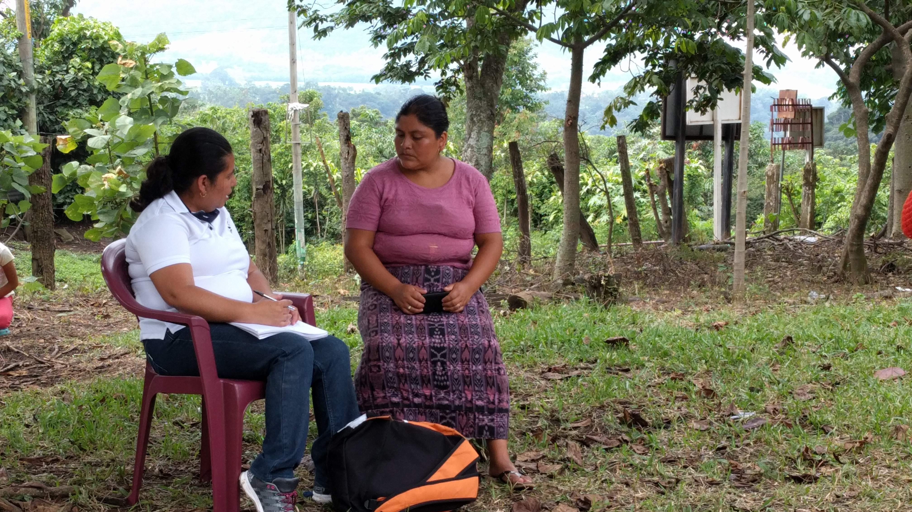
Financial Policies Manual

Slide 13
11.1 Project Initiated / External Audits
Reason for revision: Clarify that external auditors should not participate in the preparation of reports to the government. Keeping these roles separate is important for internal controls.
Audits performed by a local auditor based on local government or board requirements are referred to as Project Initiated or External Audits. The project is encouraged to engage an external auditor on an annual basis to review the financial records in accordance with local regulations.
Project Initiated audits should review the financial records to determine whether the auditor can attest that the books reflect a materially accurate statement of financial position. The external auditor also often assists with the preparation of financial reports to be presented to the government.
The external auditors should be rotated in accordance with the local regulations of the project. In the absence of regulation, the project must change the external auditors every 3-5 years.
The report from a project-initiated audit is presented to the project or local board by the auditor. The project should share the report with Unbound-Kansas, along with any action taken to implement recommendations by the auditor.

Slide 14
13 Guideline for G/L and Dept/Program Coding
Reason for revision: New department (Department 150) has been added. This department may be used in cases where the local country's requirements for classifying expenses are different than the Kansas criteria.

Slide 15
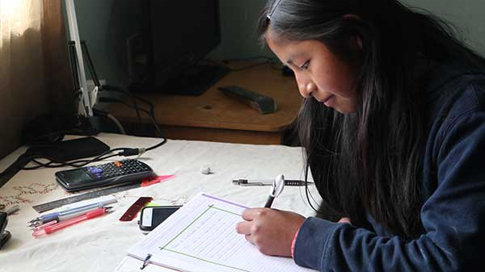
Scholarship Manual
No significant changes

Slide 16
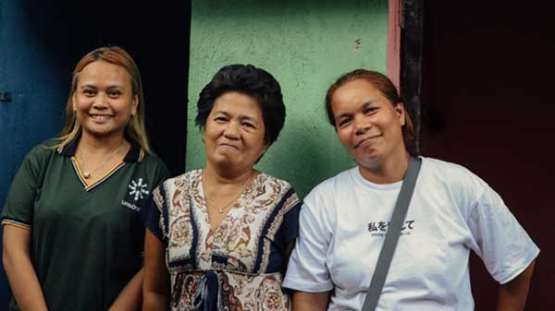
Trips Manual
No significant changes

Slide 17
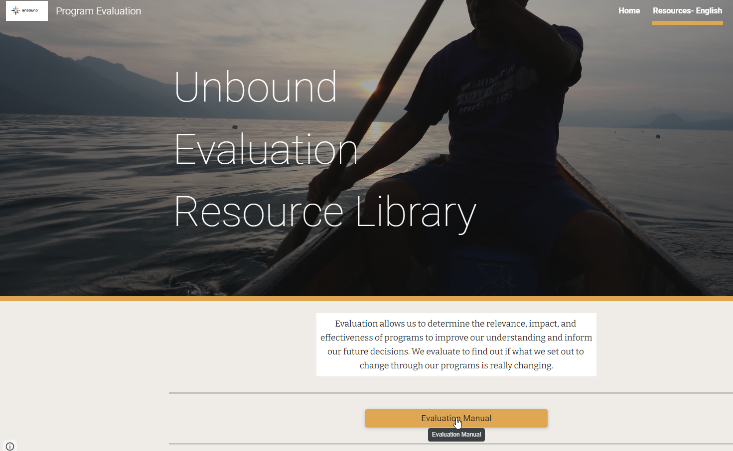
Evaluation Manual
Updated version in Program Evaluation website

Slide 18
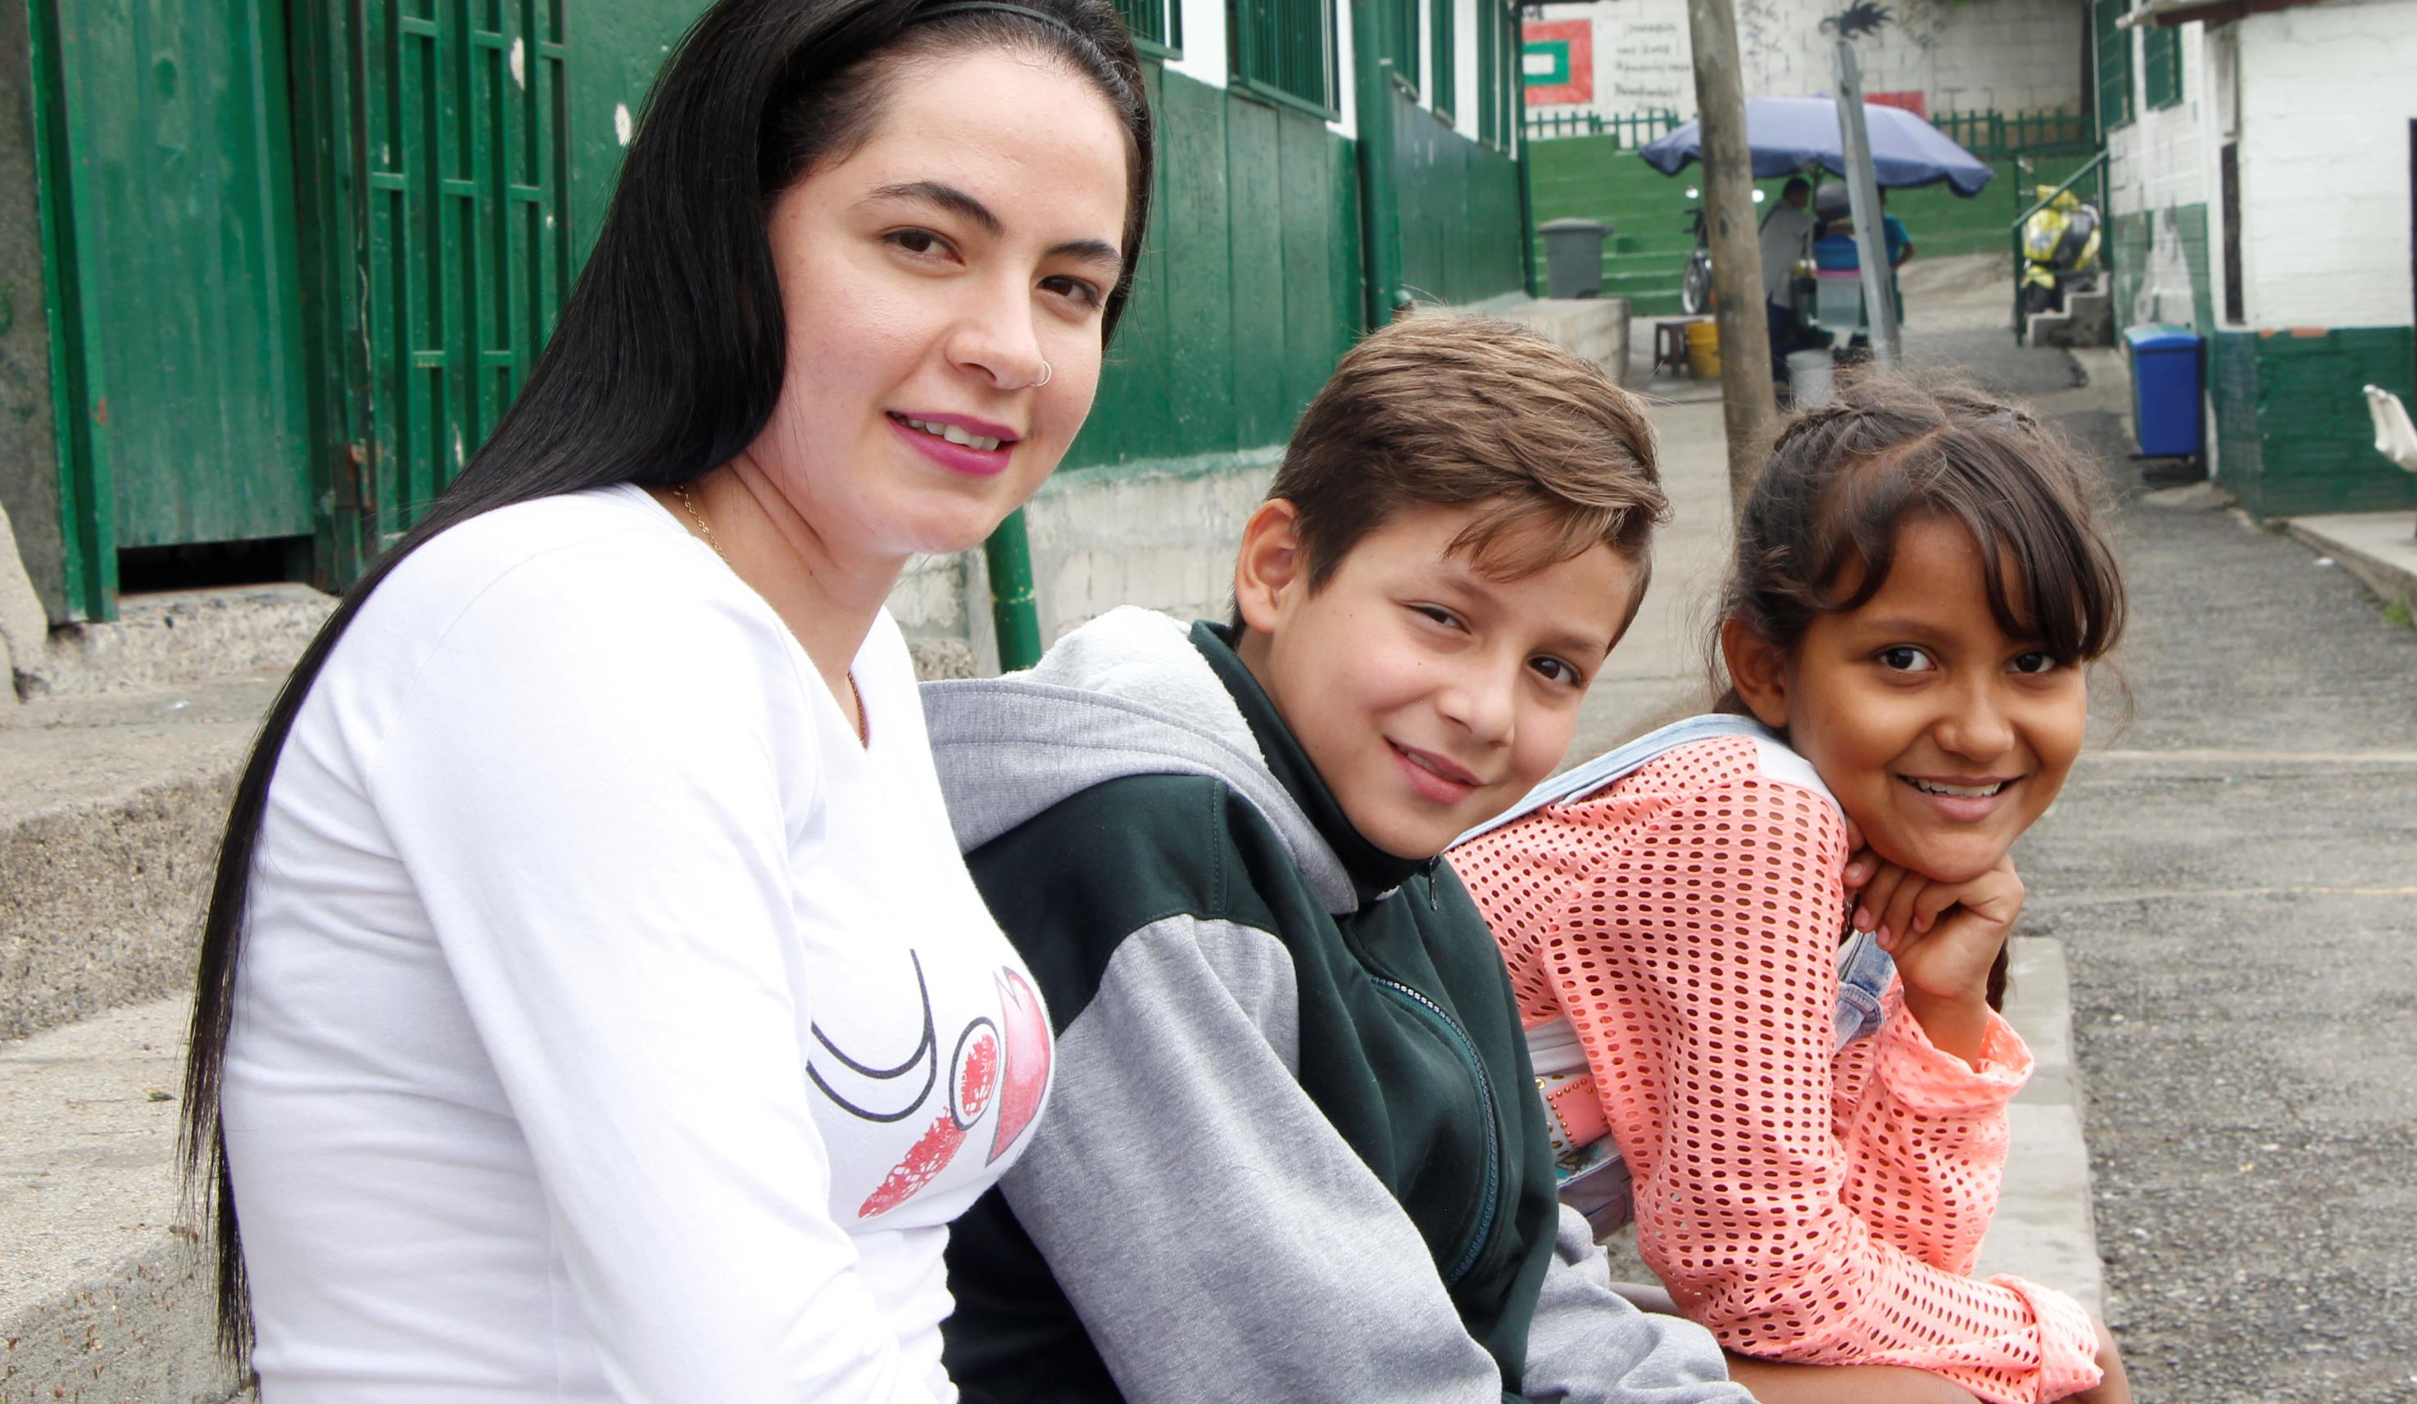
Questions?

