Slide 1
Welcome!
We Will begin in a few minutes
For greetings: Please use the “Chat” feature. Choose “All Panelists and attendees”
For questions: Please type your questions in the Q&A window on the bottom of your screen.

Slide 2
Sponsorship Manual

Slide 3
General changes
Sponsorship
Changed "Unbound-Kansas" to "Unbound headquarters" to reflect the fact that the Unbound headquarters has become geographically distributed with staff serving in multiple cities and countries.
Added gender inclusive language in the Spanish version of the manual

Slide 4
5.2.6 Poverty Stoplight
Sponsorship
Reason for revision: New section to describe the role of the Poverty Stoplight methodology and survey in Unbound’s program and communicate intention to administer the survey annually with all sponsored families.
Poverty Stoplight is both a self-assessment survey for sponsored families and an intervention model that enables families to develop practical solutions to overcome their specific challenges. Project teams collaborate with representatives of sponsored families to identify relevant indicators and create definitions for extreme poverty (red), poverty (yellow), and no poverty (green) for each indicator. This survey and methodology are a direct application of Goal Orientation tools to achieve all Unbound 9 Program Characteristics.
The survey includes three sections. The first section is socioeconomic data about the family. The second section is the family’s self-assessment for the locally selected indicators. The third section is where each family selects priorities and develops action plans to improve their status on the selected indicators. Unbound’s goal is that all sponsored families update their responses to the second and third sections (indicators and priorities) of the survey at least once per year.

Slide 5
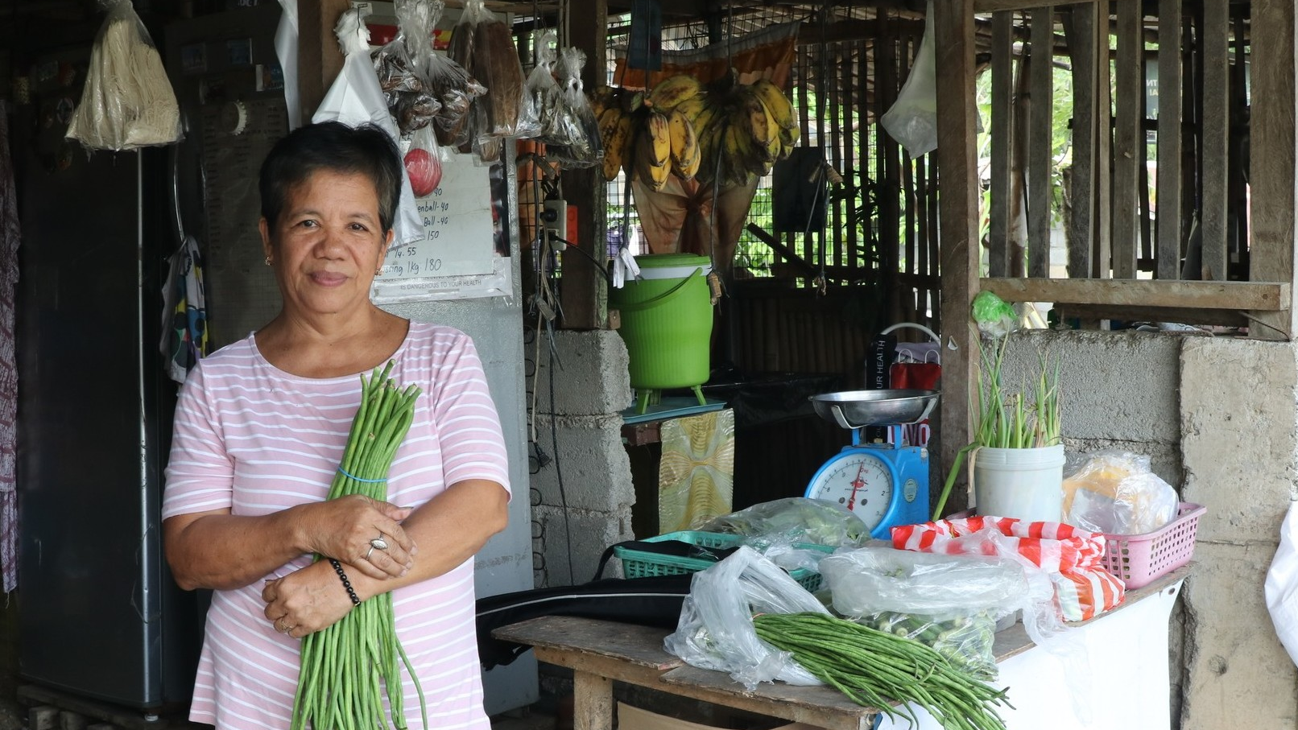
Financial Policies Manual

Slide 6
2.5.2 Individual Sponsor Visits (ISVs) and Virtual Visits
Financial Policies
Reason for revision: Changes to ISV reimbursement policy
All expenses incurred by the project related to Individual Sponsor Visits (ISV) and Virtual Visits should be recorded to Fund 45, Depto 250 under Special Visit GL Group. The project should ensure to incur reasonable expenses for theses visits.
Individual Sponsor Visits (ISVs) are an important part of the Unbound sponsorship program. The project will assume the expenses related to the ISV and maintain documentation and receipts of the expenses in order to request reimbursement, per the process described in the Financial Policies Manual.
The project’s regional team and Sponsor Support ISV coordinators are in close contact and support with each other. Projects may contact either team if there is an urgent ISV situation.
Twice per year, in May and November, the project accountant will send Kansas supporting documentation and a report which lists the expenses incurred by the project for virtual visits and individual sponsor visits (ISVs) according to the following schedule:
Send report and supporting documentation by May 10 for visits that occurred between November 1 and April 30. Reimbursement will be sent with the June transfer.
Send report and supporting documentation by November 10 for visits that occurred between May 1 and October 31. Reimbursement will be sent with the December transfer.
The report format is similar to the format projects have used in the past to submit their expenses and receipts after an awareness trip. The Kansas regional accountant will share the format with you. The basic categories include:
o Transportation
o Meal or snack
o Internet / technology (for a virtual visit)
o Other

Slide 7
2.5.2 Individual Sponsor Visits (ISVs) and Virtual Visits (continued)
Financial Policies
Reason for revision: Changes to ISV reimbursement policy
…
The project could possibly have expenses from ISVs as well as virtual visits. The project accountant should submit separate reports, one for virtual visits and one for individual sponsor visits (ISVs), organized by subproject.
Project accountant:
Will send the report (see the Excel template) with the receipts from the expenses of the visits (virtual and ISVs), in the first ten days of the month listed above, in other words by May 10 and by November 10. The project will be reimbursed during the months of June and December, respectively, with the monthly transfer sent by Kansas. It’s important the project accountant respect these deadlines to guarantee timely reimbursement and avoid that Fund 45 has a negative balance, particularly at the close of the year.
The report should be sent to Kansas regional account

Slide 8
10.4 Calendar of Financial Reports and Other Documentation
Financial Policies
Reason for revision: New financial reporting requirements
A summary of required financial reports and their frequency is noted below.
Report or Document | Frequency
Project and subproject bank statements Project and subproject bank reconciliations Project and subproject Cash Reconciliations Cash reserves report Transaction-level financial detail (non-Abila users) Normal Trial Balance (NTB) Statement of Activities (SOA) Funds Distributions to sponsored. Annual budget Comparative Quarterly Budget versus the actual Annual payroll register Proposals for salary adjustments Asset listing Inventory listing Government-required audit Copy of official bank signature card Government Tax Reports | Monthly Monthly Monthly Monthly Monthly Monthly Monthly Monthly Two months before implementation Quarterly Annually Annually Annually Annually (if applies) Annually (if applies) When bank account signatories change Annually

Slide 9
13 Guideline for G/L and Dept/Program Coding
Financial Policies
Reason for revision: New Department/Program codes

Slide 10
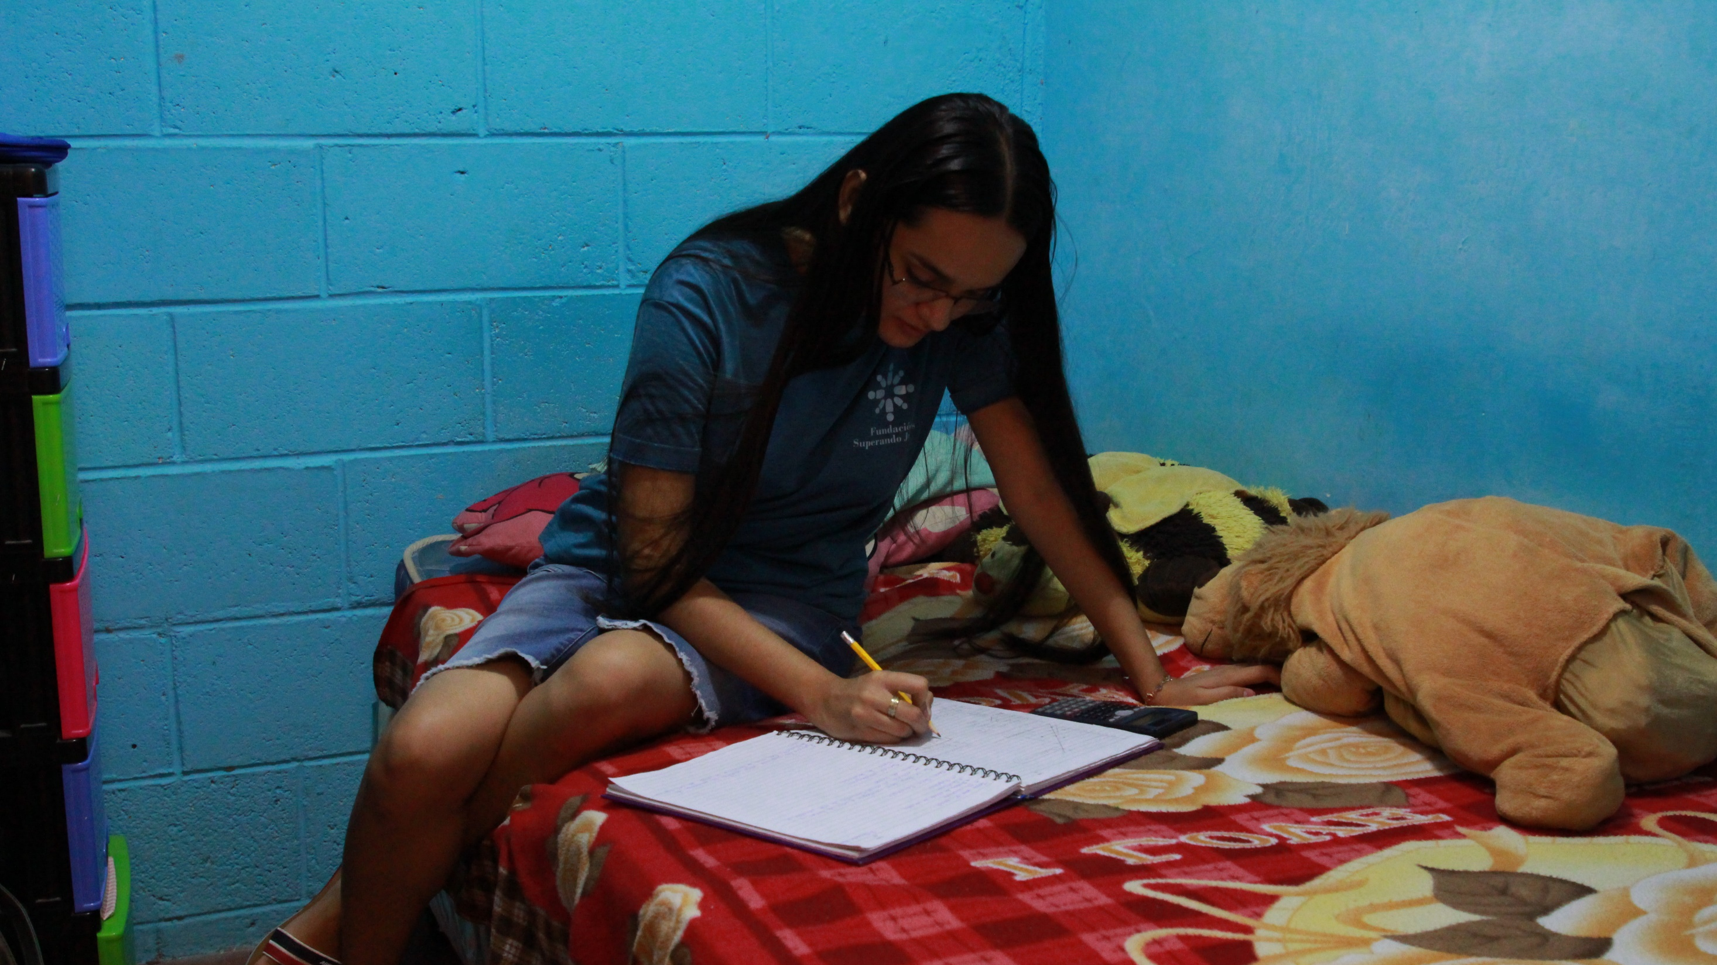
Correspondence Manual

Slide 11
3 Messages
Correspondence
Reason for revision: manual language update
Letters and videos (here on referred to as “messages”) from sponsored friends are the most important communication Unbound sends to sponsors

Slide 12
3.1.2 Messages
Correspondence
Reason for revision: Correspondence timeline update
Correspondence should be submitted as soon as possible after the family creates it. It will be declined if the upload date is more than three months from collection.

Slide 13
2.2.3 Christmas / Year End Greetings
Correspondence
Reason for revision: Elimination of section
While sponsored members and sponsors come from a variety of faith backgrounds, the Christmas season, which falls in late December, is a time of celebration for many people around the world. Unbound Kansas is evaluating on a yearly basis if projects will collect and submit Christmas or year-end greetings. Unbound Kansas will notify all projects in advance if this type of greeting will need to be collected and will share guidelines at that time. Christmas/year-end greetings do not count toward a sponsored member’s letter-writing requirements.

Slide 14
Scholarship Manual

Slide 15
Unbound Scholarship Manual
Scholarship
Reason for revision: Program name change
Unbound Service-Scholarship Manual

Slide 16
2.1 Project Eligibility
Scholarship
Reason for revision: Clarification about scholar service agreement
Please note that the primary goal of the scholarship program is to provide educational support for students, not to provide resources to the sponsorship program. Scholars may select organizations outside of Unbound in their local community or within their local Unbound program to fulfill their service commitment.

Slide 17
2.3 Community Service
Scholarship
Reason for revision: Updated community service process
The scholar must develop an individual community service plan. Consider how a scholar’s field of study, talents and/or interests could be aligned with their individual community service plan. The plan should include specifics that are meaningful, clear, and realistic. Service plans designed to serve through internships, apprenticeship, local community services, and other organizations are acceptable in accordance with local law around volunteering. Scholars have the choice to provide service to their Unbound community as well. When serving at Unbound, scholars’ time should not replace the daily responsibilities and tasks of project staff nor match the workload. While some individual service plans for scholars may include service to the sponsored community or local office (especially where relevant to a scholar's area of study), the individual service plan for a scholar should not be designed to maintain local project workflows or monitor sponsored member requirements.
The service requirement should represent a significant and meaningful commitment for the scholar and community.

Slide 18
2.4 Scholarship Amount
Scholarship
Reason for revision: Clarification about scholarship funds
Scholars who are struggling to comply with established policies should receive personalized accompaniment from program staff. If non-compliance with policy persists staff should retire the scholar from the program. Withholding of scholarship funds cannot be used as a strategy for correction or sanctioning.

Slide 19
5.2 Appendix – Sample Letter of Agreement
Scholarship
Reason for revision: Clarification about service aspects of scholarship program in updated report
Third: The scholarship recipient will conduct a meaningful service project or contribute ______ hours of community service per _______. The scholar agrees to provide the following community service: This agreement is voluntary and only applies to the receipt of academic scholarships. Under no circumstances will the scholarship scholar be subjected to the responsibilities of a labor relationship. Therefore, no rights or obligations pertaining to a labor relationship will be granted.
Fourth: The scholarship recipient agrees to provide the following community service: __________________
Fifth Fourth: All of the days of formation and other service scholarship activities programmed by Unbound are considered part of the program; therefore, the scholarship recipient and/or his/her guardians should attend as indicated.

Slide 20
5.4 Appendix – Sample Individual Community Service Plan
Scholarship
Reason for revision: Updated report
The scholar has voluntarily agreed to perform community service during the following: • Months of service/work: __________________________________________
• Days of the week: ________________________________________________
• Hours of the day: ________________________________________________
Special events to be programmed:
How will community service/work be recorded and reviewed?
How will community service be monitored?

Slide 21
5.5 Appendix – Sample Community Service Form
Scholarship
Reason for revision: Updated report
Total of hours: ___________
In what areas did the scholar perform well? In what areas could the scholar improve?
How was the scholar’s attitude while carrying out service?

Slide 22
Trips Manual / Vocations Manual
No significant changes

Slide 23
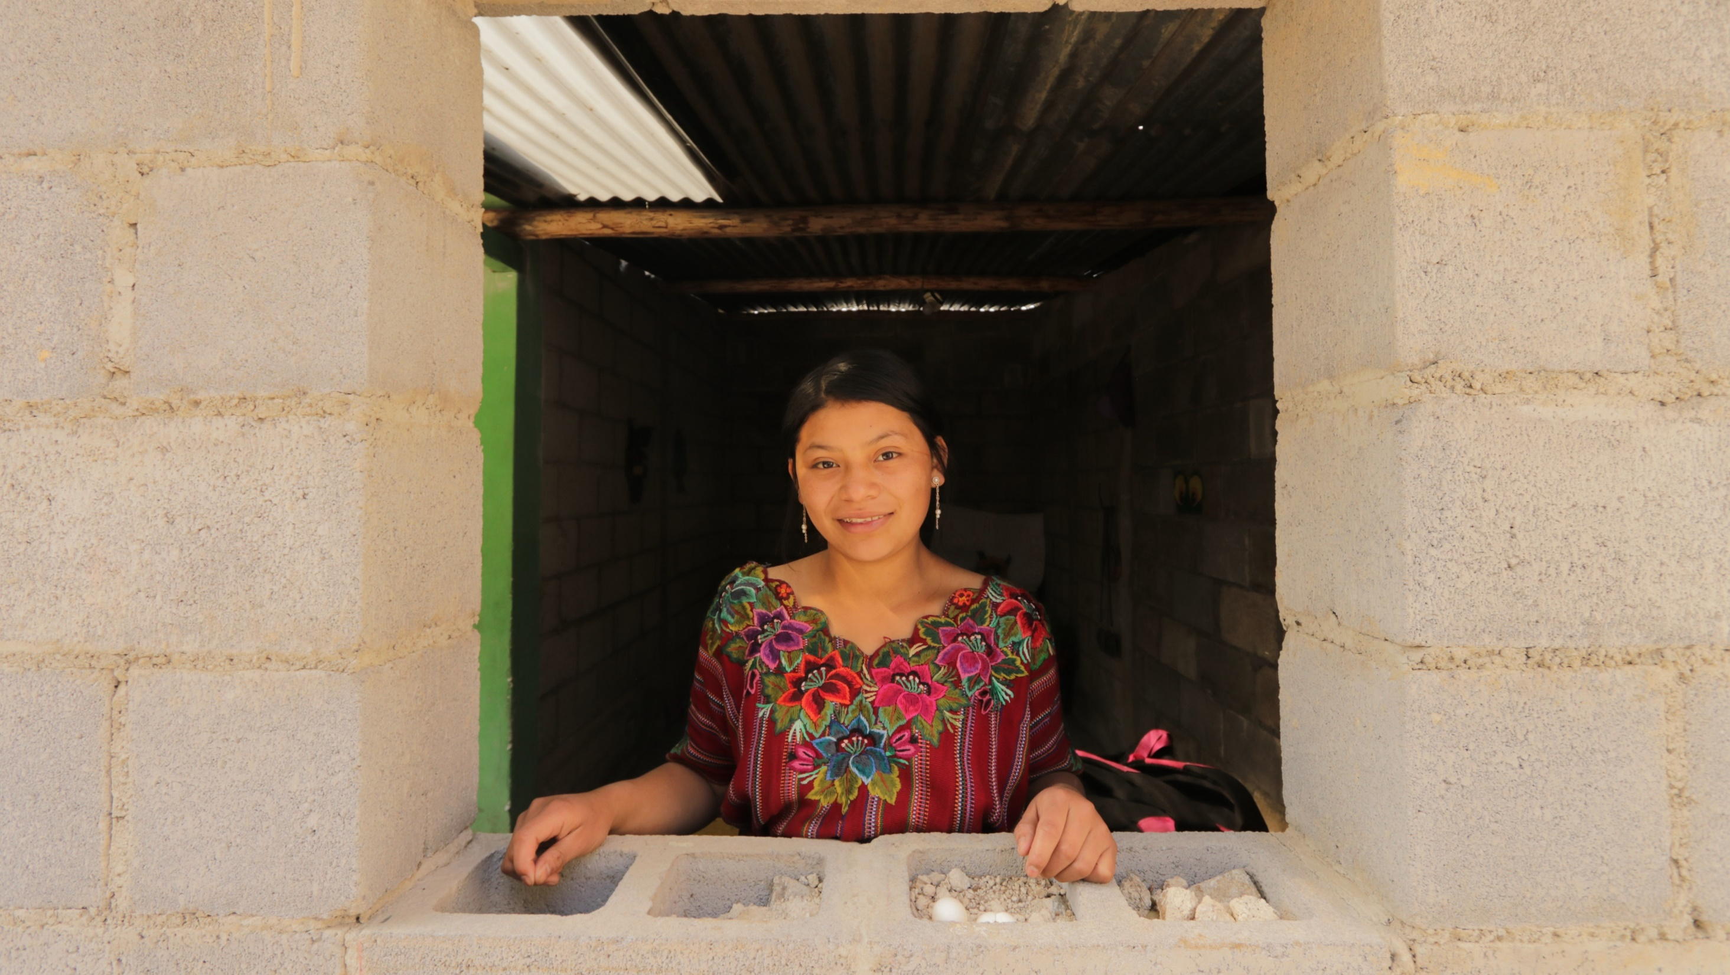
Questions?

