Slide 1
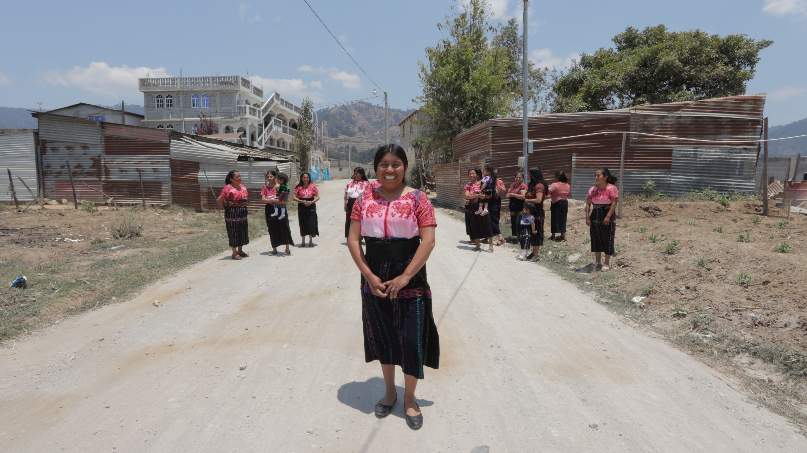
2025 Manual revisions
Welcome!
We will begin in a few minutes

Slide 2
Sponsorship Manual

Slide 3
2.2.4 Board composition
Sponsorship
Reason for revision: To clarify parameters of service for project staff members who serve on boards.
Given the nature of a shared responsibility to honor shared commitments to sponsored families and sponsors, where allowed by local law, Unbound headquarters generally recommends some international representation on the local project board. These representatives may be Unbound headquarters representatives, members of other project boards or teams, or other members of the Unbound international community. Current staff members should not be eligible for participation in the board of their own project entity. When possible, members of the sponsored community or former beneficiaries should be considered as part of the board composition. The count of Unbound headquarters representatives shall not constitute a majority of the local project board. Where there are 5 board member positions, Unbound headquarters will typically request 2 representatives. Where there are 7 board member positions, Unbound headquarters will typically request 3 representatives. The goal of the board composition is to provide adequate representation of the global Unbound community. The spirit of Unbound headquarters participation is to provide adequate representation, while not exercising control over board activities or decisions.

Slide 4
4.2.7 Henry Perez Professional Development Scholarship
Sponsorship
Reason for revision: This new section describes the scholarship fund for project staff members.
The Henry Perez Professional Development Scholarship is intended to support the education and professional development of staff members at Unbound projects. The purpose of these funds is that they be used to invest in the professional development of project staff members. Each project is responsible for determining a fair selection process that includes diverse staff representation. The intention of the scholarship is not to replace the inclusion of staff development and training initiatives as part of the project budget and workplan.
Henry Perez was a project staff member in Peru who had a lifelong commitment to learning to continually improve his skills and made a positive impact on the world. These scholarships are intended to honor his memory and uphold his spirit as an active presence in Unbound communities around the world.

Slide 5
5.2.4.3 One Sponsored Member per Household
Sponsorship
Reason for revision: New policy makes the Unbound sponsorship program accessible to more families
Projects should not enroll more than one person in a household except in extraordinary circumstances. Sponsorship benefits and services should help the entire household, and limiting enrollment to one person per household allows the program to reach as many families as possible. Families with additional ongoing needs are also eligible for complementary programs. Exceptions can be made for special circumstances. Please notify the Unbound headquarters regional team about people who are identified as special cases requiring an exception before submitting the records. Any exceptions should be reviewed regularly to ensure the household still qualifies for more than one sponsorship in the household.

Slide 6
5.2.5 Active participation
Sponsorship
Reason for revision: To prohibit withholding of sponsorship funds as punishment for non-participation. Sponsored families who do not participate may be retired, but they should not be kept in the program with funds held for non-participation.
Project teams should have regular interactions with sponsored members and their families to be certain that sponsored members are present, receiving benefits, and active in the program. Projects should retire a sponsored member if a sponsored member and/or family representative of the sponsored member have not participated in the program for more than 90 days. Any exceptions should be communicated to the Unbound headquarters regional team. Projects should not withhold sponsorship funds from families to promote active participation.

Slide 7
6.2.1 Communication between sponsors and project staff
Sponsorship
Reason for revision: To clarify that only direct communication with sponsors about program-related topics requires coordination with Unbound.
All project staff shall follow a professional code of conduct concerning their behavior or communications with an Unbound sponsor. Project staff should not communicate directly with a sponsor except in special situations to arrange an individual sponsor visit (ISV). In order to maintain good coordination and transparency, project staff and sponsors/donors should not make personal requests, interfere with the sponsorship program, or communicate directly about Unbound programs and business. In special situations or for emergency during ISVs, Unbound staff may provide contact information for a sponsor for a limited time of use. Communications between sponsors and project staff about Unbound programs and business must be sent through Unbound headquarters.

Slide 8
6.4.3 Standard ISV timeline
Sponsorship
Reason for revision: To extend the required timeline
Sponsors are required to complete an ISV application at least 60-90 days before the proposed ISV date and submit to a background check (this is a search to attempt to reveal any criminal history and serves as a tool to assess whether a person should travel with Unbound).

Slide 9
6.4.5.3 Possible ISV participants
Sponsorship
Reason for revision: To clarify existing policy
Only approved visitors should be allowed to participate in a visit. Notify ISV coordinators by email or whatsapp if an unapproved visitor is brought to the ISV location.

Slide 10
6.4.5.5 Location of an ISV
Sponsorship
Reason for revision: To require an ISV location
ISVs should occur at a local project office. A meal or snack appropriate for the time of the visit should be included in the speed letter response. It is appropriate to go to a nearby restaurant as part of the visit.
It is not permitted that the visit take place at a hotel or sponsor’s place of lodging.

Slide 11
6.4.5.7 Length of visit
Sponsorship
Reason for revision: To clarify the appropriate timing & length of an ISV
We recommend that visits start no earlier than 9am local time and are no longer than 6 hours.

Slide 12
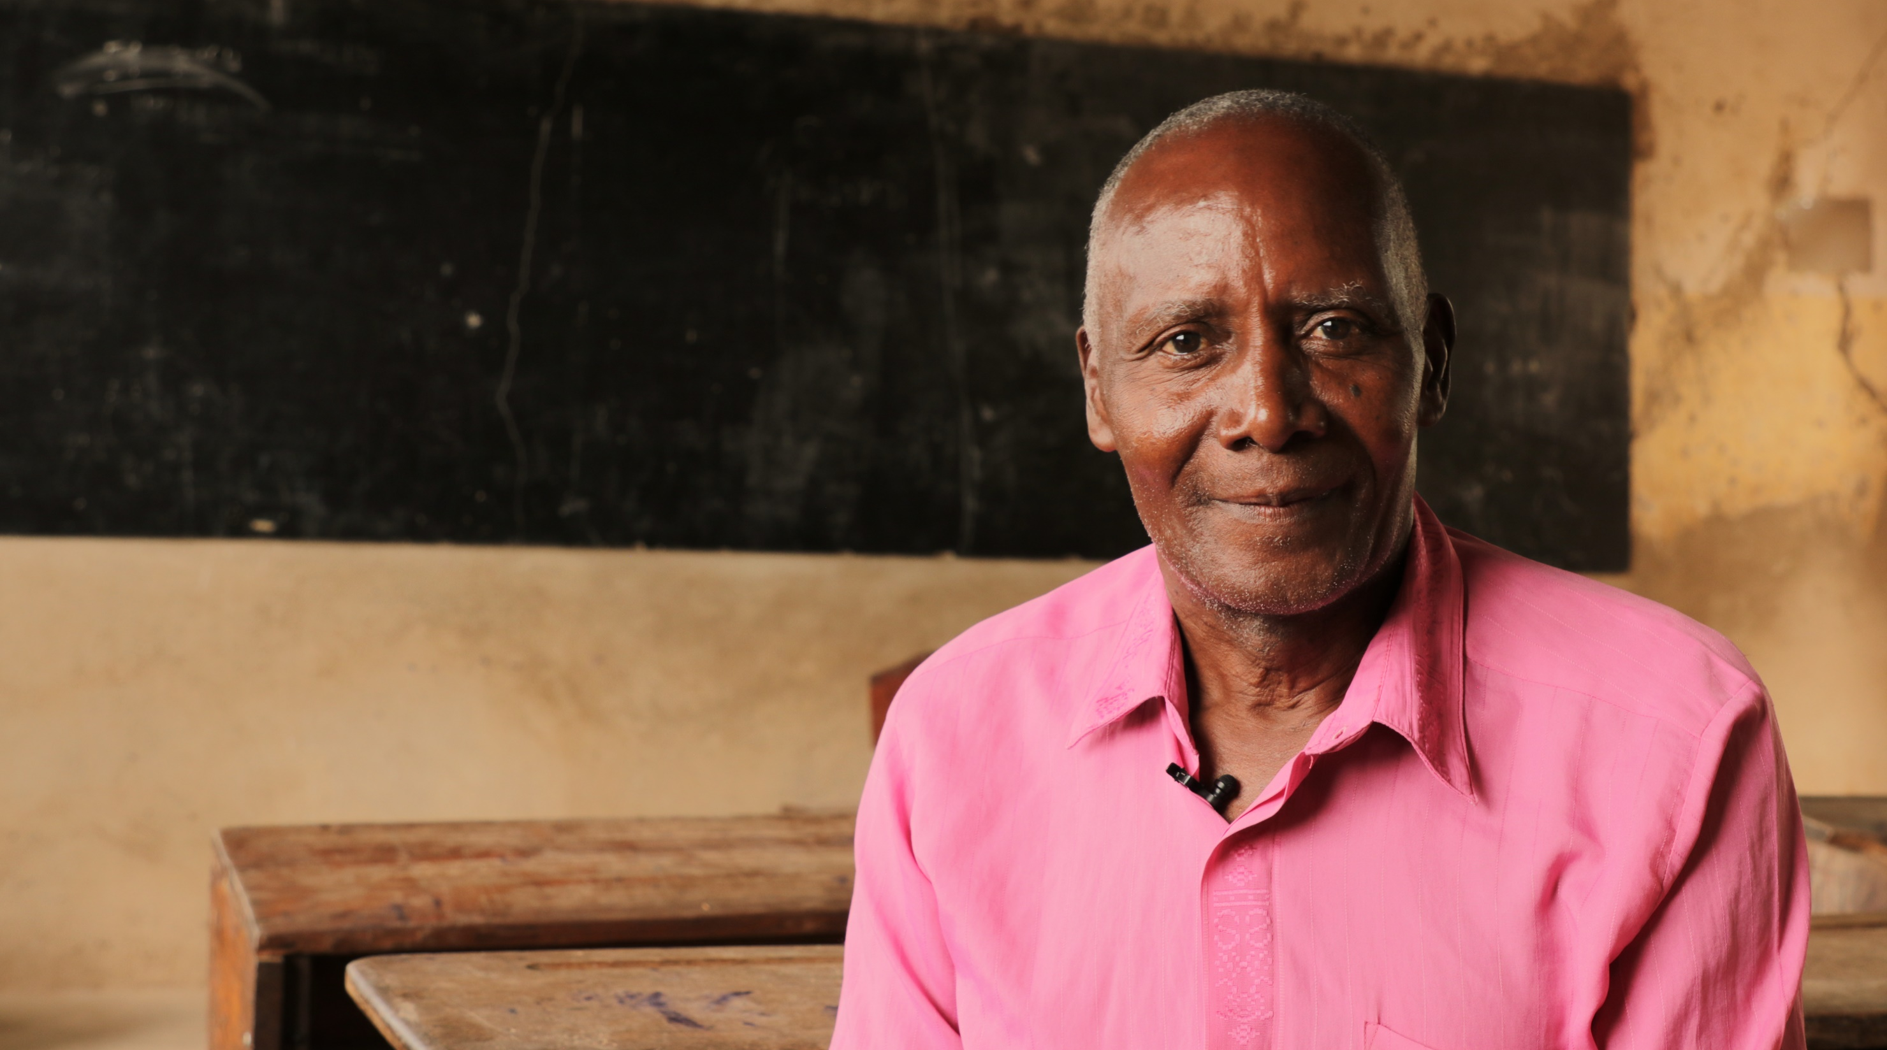
Financial Policies Manual

Slide 13
3.2.2 Donations from a sponsor received by project office
Financial Policies
Reason for revision: To remove requirement that checks be sent to Unbound headquarters
For checks received, report them on the Portal and destroy them immediately.
Refer to the correspondence manual for more information on how to register checks in the Portal.

Slide 14
4.2.3.1 Petty cash
Financial Policies
Reason for revision: To raise the amount permitted in petty cash expenses and reduce from two required approvals to one approval
Petty cash refers to a small amount of money held for administrative expenses between USD 20 and USD50; replenished monthly by the amount spent and documented with receipts. The amount held in the project or subproject offices for petty cash purposes should be capped at USD 300.
If a higher cap should be necessary, the project must secure approval from Unbound-Headquarters. Approval should be renewed annually during the budget approval process.
All withdrawals from the petty cash account must be approved by an authorized staff member prior to the withdrawal and tracked in a cash log on a daily basis. Approved expenses from petty cash are typically intended for administrative purchases.

Slide 15
7.3 Authorizations
Financial Policies
Reason for revision: To clarify type of expenditures requiring authorization
All assets or program and administrative expenditures that exceed a total purchase of USD 1,000 must be documented on the purchase authorization form and approved by the Unbound-Headquarters office.
If the size of the project is 5,000 beneficiaries and above and USD 1,000 implies a lot of requests of approvals, the project could ask the Unbound Head Quarters offices an increase of this amount, according to their real needs.

Slide 16
7.6.2 Records retention
Financial Policies
Reason for revision: To increase internal controls for employee files
It is recommended that employment information be archived permanently.

Slide 17
7.7 Local financial manual
Financial Policies
Reason for revision: To require that each project have a local financial manual
A local financial manual is essential because it provides a standardized set of guidelines and procedures for managing finances at the local level, often within government entities, nonprofit organizations, or small businesses.
Each project is required to have their Local Financial Manual, considering the Kansas Financial Manual guidelines and their own policies. The project must update their manual at least once a year.

Slide 18
Correspondence Manual

Slide 19
2.4 Processing at Unbound headquarters
Correspondence
Reason for revision: Change in Unbound headquarters annual photo process
Once the photos have been submitted to Unbound headquarters, facial recognition software is used to review all photos and will notify the Child Services team if the photo is a duplicate of a previous photo, or if it does not appear to be the same person. Then a member of the team reviews the photo to approve it or decline it.
A substantial portion of photos will not undergo manual review by a headquarters staff member. Given these considerations, it is important that project staff review photos before submission for certain aspects of photo content, such as clothing featuring profanity or inappropriate imagery, identifying information, or attire considered inappropriate and ensure that photos meeting these criteria are not submitted.

Slide 20
3.4.2 Content requirements
Correspondence
Reason for revision: Change in language guidelines for video messages
Language preferences
Sponsored members are encouraged to speak in the language in which they are most comfortable. If the sponsored member/guardian does not speak English, the following options are available:
Interpretation: an interpreter may appear in the video. The sponsored member or guardian should speak a few sentences in their local language, then the interpreter should alternate speaking in way throughout the video as opposed to having the sponsored member/guardian share their entire message at one time, followed by the entire interpretation in English.
Subtitle translation: The sponsored member/guardian may record the entire video in their local language. Once the video is uploaded to Portal, the subtitles can be edited to English. (See Portal User Guide for more information about editing subtitles.)

Slide 21
6.2.2 Youth in change of sponsor
Correspondence
Reason for revision: To reflect a process change for updating future retirement dates on exit pages that have already been submitted to Unbound headquarters
To indicate Option 2, please submit an exit page through Portal and change the retirement date to indicate the future date that the youth will complete their education. Please make sure that future retirement dates are set before the 15th of the month, to support Unbound headquarters processing.
If the future retirement date needs to change after the exit page has been submitted, please email your Regional Project Specialist with the new retirement date.

Slide 22
Scholarship Manual

Slide 23
2.3.1 Individual community service plans
Scholarship
Reason for revision: Clarify scope of community service plans outside of the sponsorship program
Community Service plans that will take place outside of the sponsored community should be with another confirmed organization or institution that can sufficiently supervise participants.

Slide 24
5.7 Annual Program Report – page 2
Scholarship
Reason for revision: Added column for number of years the scholars have been in the Scholarship program

Slide 25
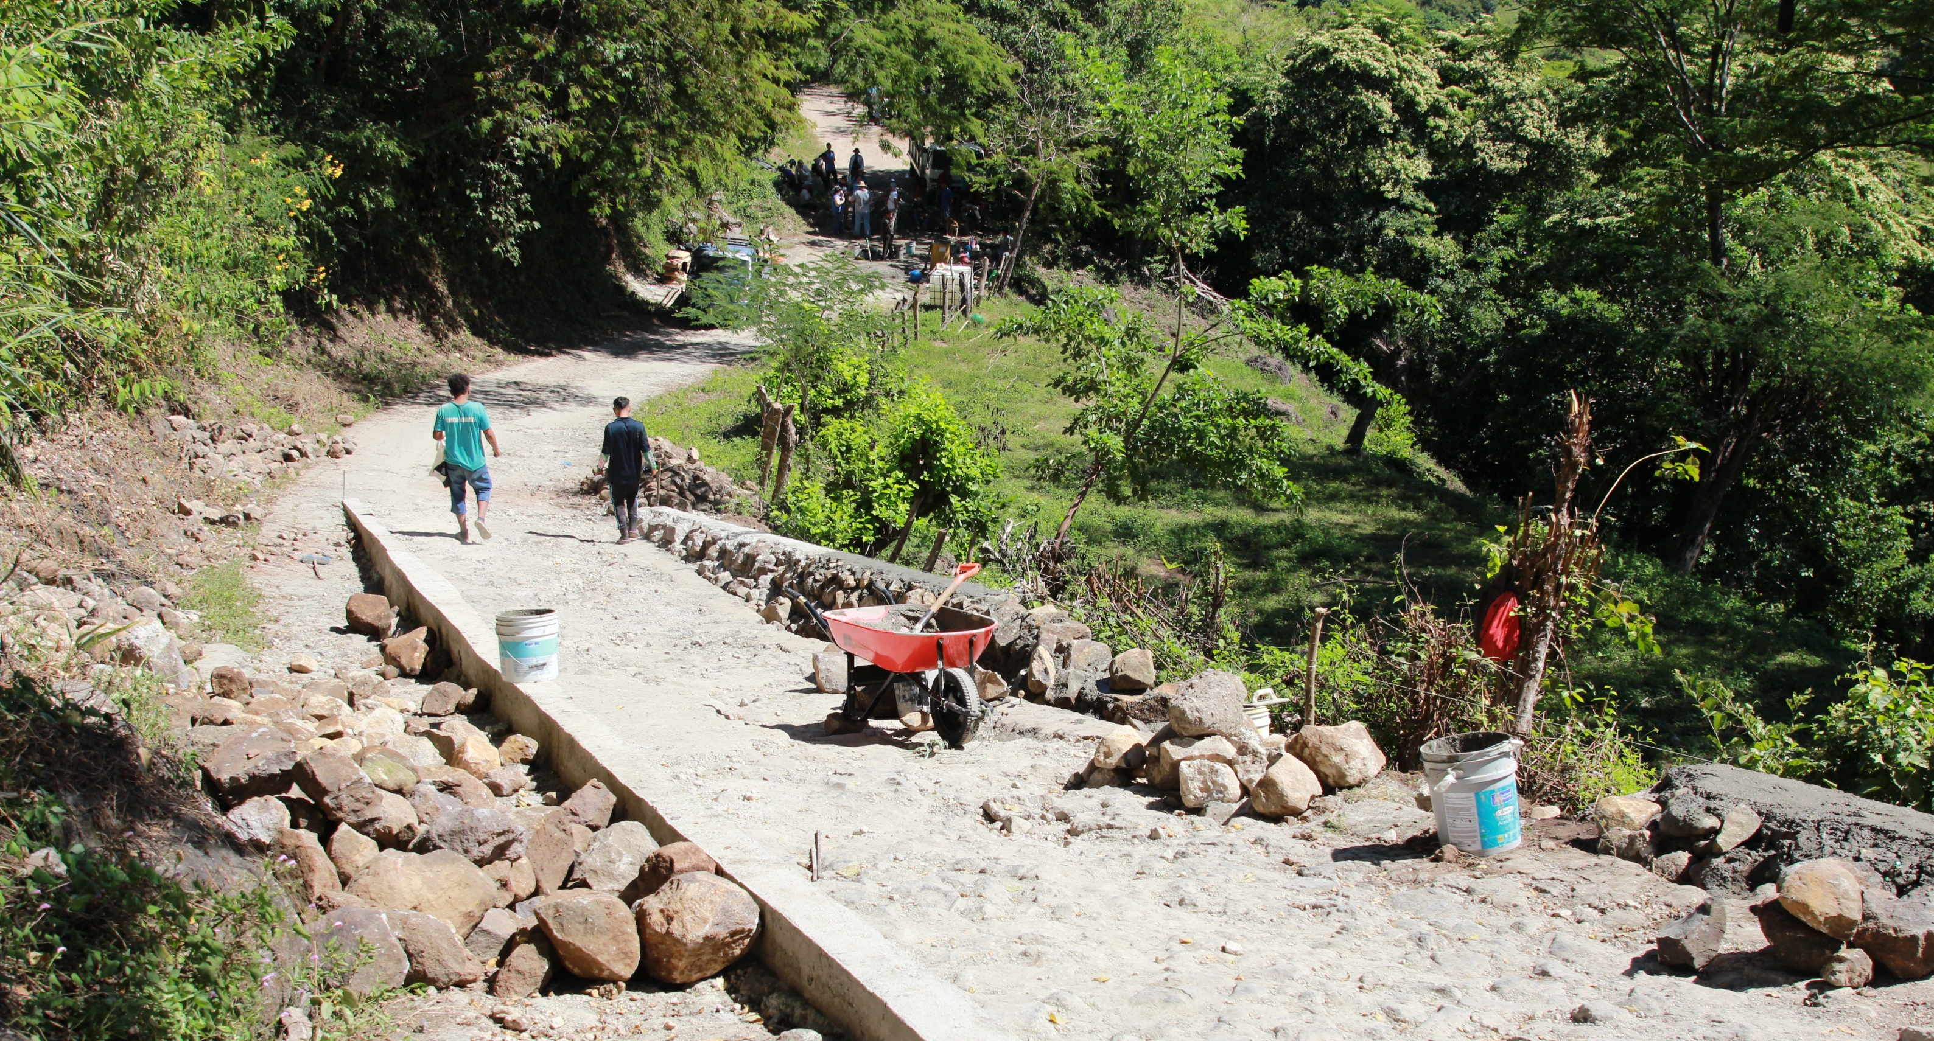
Agents of Change Manual

Slide 26
1.4.1 Program Reserve
Agents of Change
Reason for revision: New policy provides guidance for unused AC funds, errors in transfers, or cases of nin-viable initiatives
If a funded Agents of Change initiative is unable to be implemented or no longer requires the AC grant received from Unbound, the project must notify the Regional project director immediately for instructions. If advised to retain the fund, the project may accumulate a program reserve designated for Agents of Change. This should be accounted for and tracked on the Cash Reserve Report. These funds may be utilized as needed to supplement funds of other Agents of Change initiatives that due to inflation, cost of materials/labor changes, or failed local fundraising, are facing financial barriers to completing an already approved initiative. These funds are not to be used for other programs. Finally, Agents of Change Program reserve shall not be used to pre-fund initiatives submitted to KS, or to fund additional initiatives without authorization of the selection committee and Regional project director.

Slide 27
4.1 Timeline
Agents of Change
Reason for revision: To provide greater organization & accountability for monitoring of initiatives and ensure timely feedback to donors
Outcome reporting will only be requested on initiatives that were funded directly by individual or group donors. Portal will indicate which initiatives will require outcome reporting. When an initiative is marked as funded, an estimated end date for reporting is calculated based on the estimated time needed to complete it provided in the Basic Info section.
For example, if an initiative is funded on 1 April and the estimated time needed to complete in days is 60, the estimated end date is 1 June, or 60 days after 1 April. On the estimated end date, if the initiative is in Funded or Initiative in Progress status and the initiative was funded by an individual grantor (not from the general Agents of Change Fund in Kansas, which is funded from smaller AC donations), it will automatically change to Final Outcomes Requested to indicate that the final outcomes are due. Outcomes Report Estimated Due Date should be used as a guide that allows 60 days after estimated completion of the initiative. Prompt reporting will help to make sure that group accomplishments are captured and donors receive timely feedback. Final outcomes are not required for initiatives funded from the general AC fund, but they can be managed locally if the project would like to complete them for their own records or project level reporting.

Slide 28
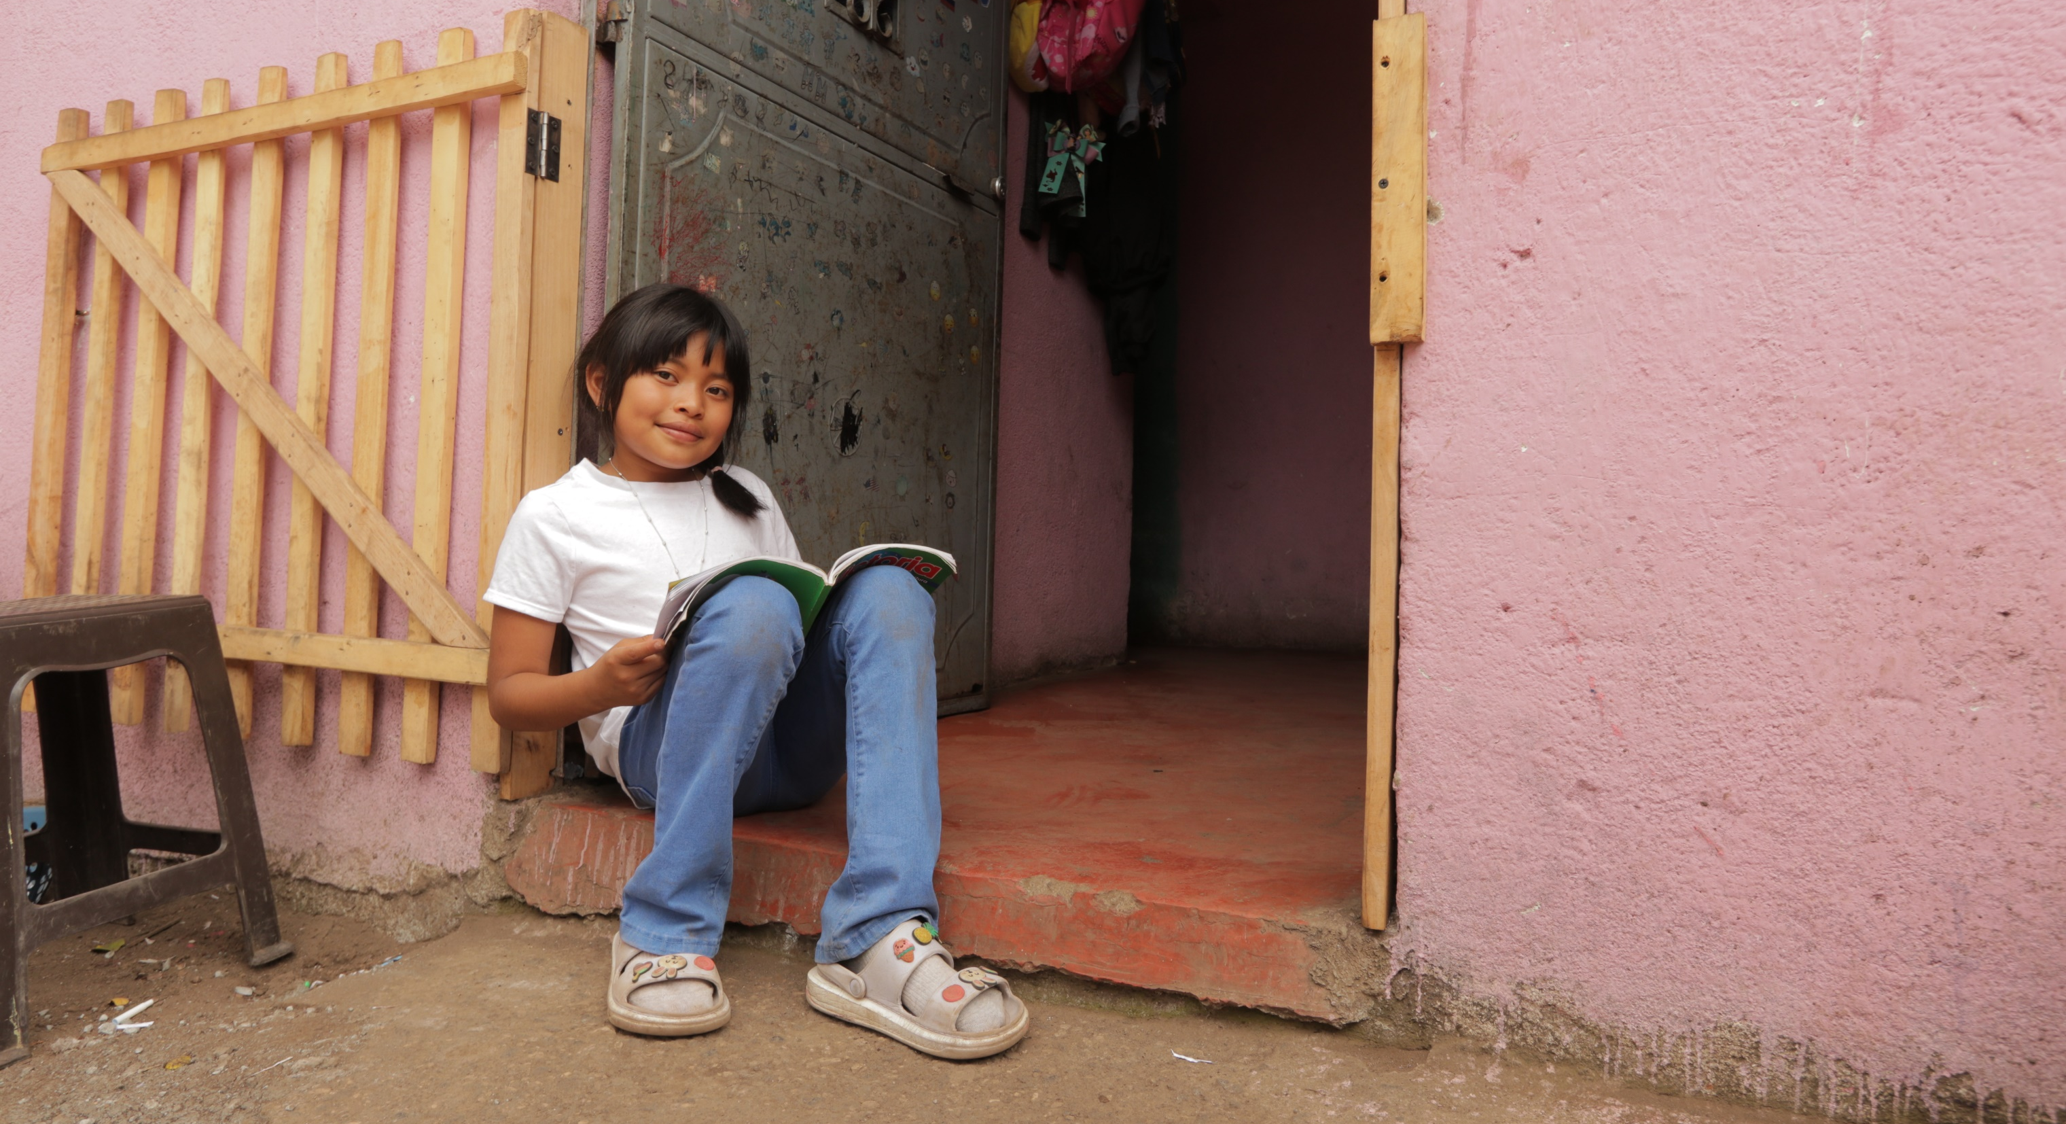
Questions?

